Slide 1


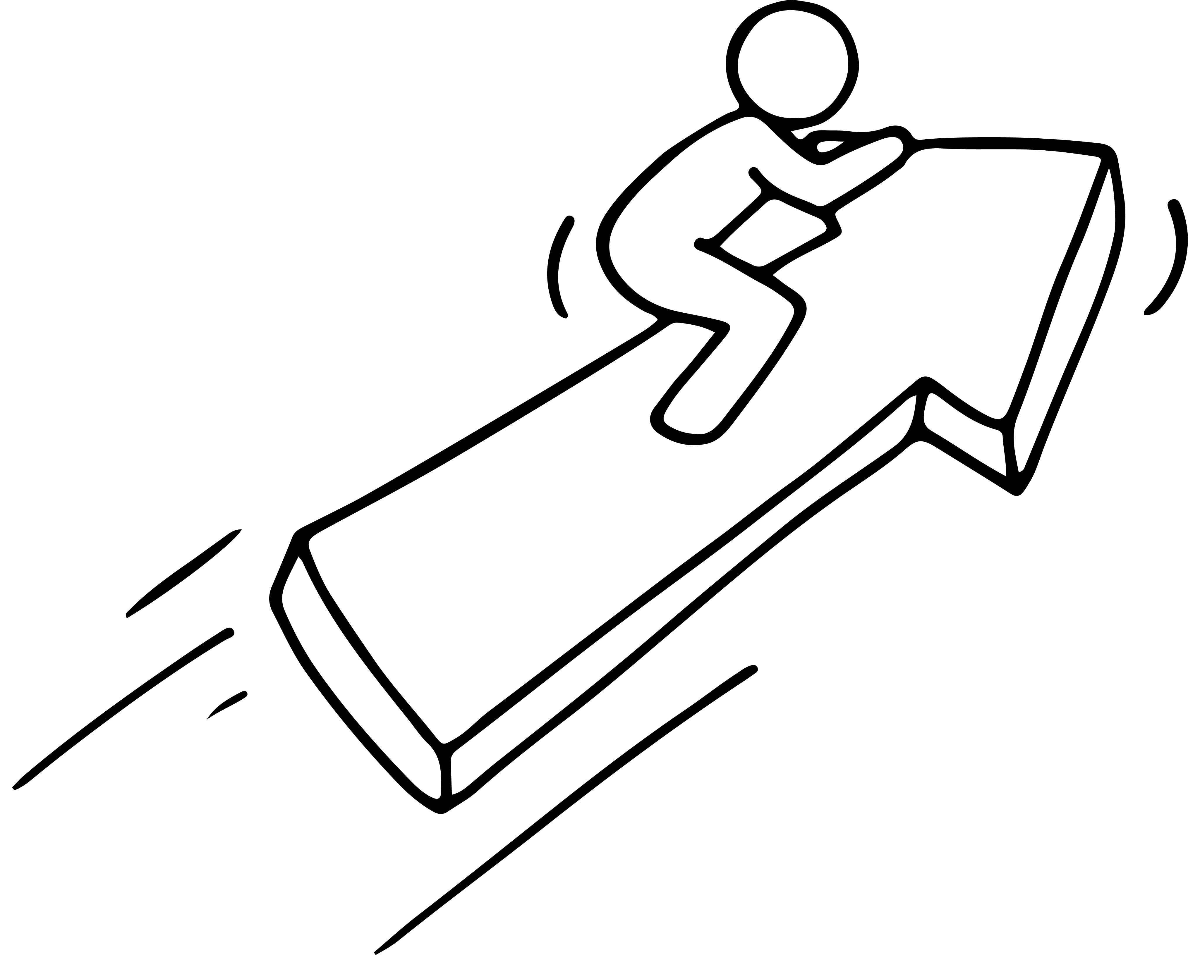

STEP 3
Getting your Business Started
You have researched your market, now let’s get your business up and running!
This project has been funded with support from the European Commission. This publication [communication] reflects the views only of the author, and the Commission cannot be held responsible for any use, which may be made of the information contained therein.

Slide 2
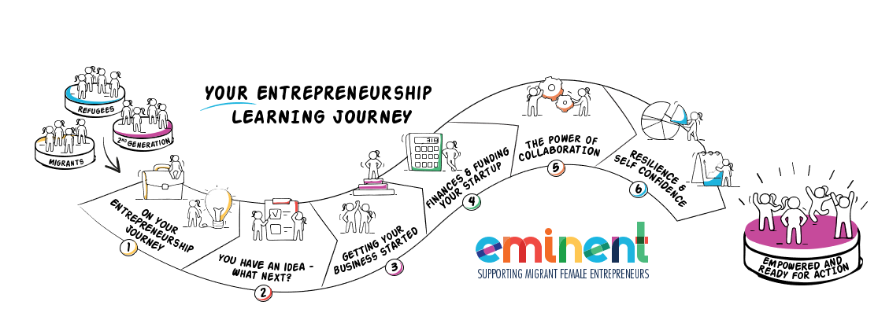
ENIMENT wants to enable Female Migrant Entrepreneurs. We want to bring you on your learning journey to gain the knowledge and skills you need to gain the confidence to establish and successfully run your own business.
Can you ? Of course, you can. Open your mind and let us bring you on Your Entrepreneurial Learning Journey…….

Slide 3
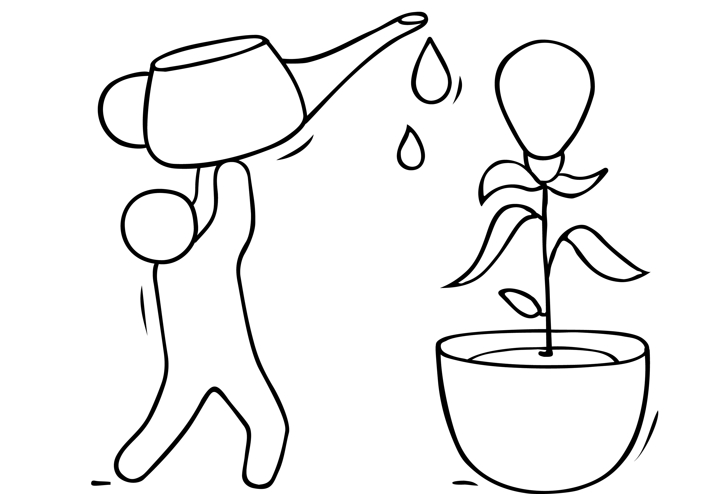
IN STEP THREE, YOU WILL LEARN
PAGES
Being in Business - Making Products Vs. Delivering A Service 3- 18
Start through an Online Business 19- 42
Start up in business with your own website 43 -45
Operations – The ‘How’ of Being in Business 46- 62
The Legal Part of Getting into Business 63-73
Operating through your own website
Step 3 is focused on building on your research findings from Step 2 and bringing it into the planning of your operations. We have been careful to make this learning as accessible as possible. This content is very much about ‘common sense’ – a much needed ingredient in setting up your business ☺
COMMON SENSE IS A FLOWER THAT DOESN’T GROW IN EVERYONE’S GARDEN !

Slide 4

Being in Business …
Making Products Vs. Delivering A Service

Slide 5
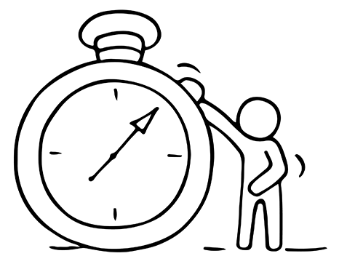
BEING IN BUSINESS – YOUR CHOICES
In this section, we take you on a learning journey through the different and accessible ways of starting and being in business.
Manufacturing a product or providing a service
Part-time or seasonal basis
And then take you on a journey of the possibility
of starting online

Slide 6
1) MAKING PRODUCTS/ DELIVERING A SERVICE
A product is one that's measurable, touchable, visible or comes in packaging. You manufacture it or prepare it for sale. Your potential customer can examine it. Of course, most products have an element of service – customer service - in them.
A service, on the other hand, isn't something you can try out before you pay for it. Customers purchase your skills of a service provider or owner. This type of business has a strong emphasis on the client relationship and makes the customer's user experience very important.

Slide 7
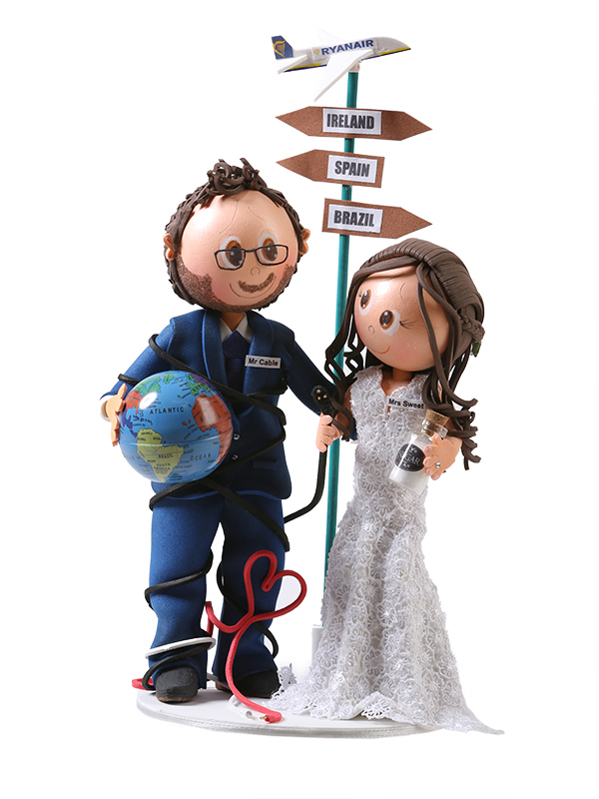
MAKING PRODUCTS - an example
Ana Tereza Rodrigues came Dublin/Ireland. from Goiânia, Brazil to Having finished finished college two years before, she was ready for new opportunities. Ana spent few years struggling to learn the language while working a few jobs. One day, encouraged by her friend So You was born making amazing cake Toppers for all occasions e.g. Weddings, Birthdays, Christenings.
The toppers are very unusual and unique. Ana sells through her website www.soyou.ie
Her story was featured in the Irish Times. Read and be inspired Migrant women’s ‘determination and grit’ find form in start-ups (irishtimes.com)

Slide 8
MAKING PRODUCTS - an example
www.soyou.ie
‘Language barrier’
“It was not very easy because the language barrier is the first difficulty,” said Ms Rodrigues. “We need to search for everything and we don’t know the terminology for everything.”
Ana still encounters barriers such as when she applied for a €10,000 loan for materials. “I tried once but it wasn’t approved and I never tried again,”
She hopes one day to have her own premises where she can both work and show off her products.
“I would love a little shop. That would be my dream,”

Slide 9
SERVICES WHEN THE BUDGET IS TIGHT
One of the most important aspects of a business running on little money is the big idea. Most service businesses cost less to set up/ establish.
Some of the best businesses you can start with no/little money is a service business. Even if you ultimately want a product business, owning a service business can help you get there.
Example of service business:
If you know another language -offer translation services
If you have an accounting degree - offer accounting services
If you know how to sew –set up a fashion upcycling service
If you are knowledgeable about social media -offer content management services

Slide 10

SERVICES WHEN THE BUDGET IS TIGHT
Everyone is qualified because each of us has skills, knowledge or experience that other people are willing to pay for in the form of a service.
Setting up a service business can suit a part time arrangement to earn extra money, work from home, or start and operate a full-time business, regardless of age, business experience, education or current financial resources.
SELF ASSESSMENT: ASK YOURSELF THIS QUESTION:
"What skill(s) do you have that can be sold as a service?"

Slide 11
SERVICES WHEN THE BUDGET IS TIGHT
Convenience-craving consumers are always looking for a way to do things better, faster and cheaper – how can your service help ?
Let’s look at just TWO areas of opportunity:
Personal Services/ Home Services
Business Services

Slide 12
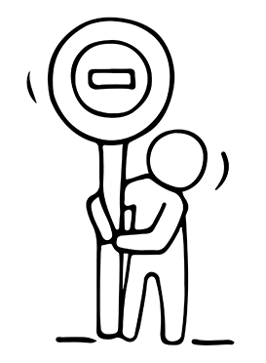
PERSONAL SERVICES/ HOME SERVICES
Just some examples of personal/home service businesses where your services are bought by the end user ..
Personal Chef
Tailor, garment alterations
Landscape garden designer
Mobile Pet Grooming
Personal trainer, fitness instructor
Nutritionist
Music tutor
Children’s entertainer
EXERCISE: WHAT OTHER SERVICE BUSINESSES CAN YOU THINK OF ?

Slide 13

SELLING A PERONAL SERVICE- an example
WATCH
Meet Karoun Baghboudarian, a Syrian musician who runs her own business KIDDY ORCHESTRA in Groningen, The Netherlands. She has a fascinating story to tell.
Visit Karoun’s website
Media - Karoun Music

Slide 14

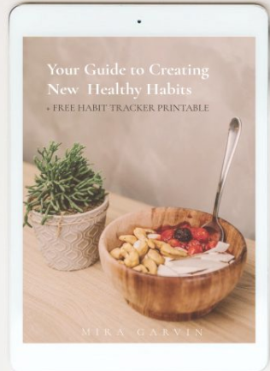
SELLING A PERONAL SERVICE- an example
Mira Garvin lives in Dublin, but is originally from Mauritius, and turned a passion for food in her adopted home into a business as a health and nutrition coach.
Wellbeing challenges led Mira to start a food blog and to train as a nutritionist. An example of one of her services, she runs a 10-week programme called Project Me for mothers with newborns to help them make easy, healthy meals.
https://everydaycookingwithmira.com/actionable-steps-healthier-habits/

Slide 15

SELLING A BUSINESS SERVICE –
Business services are services that are primarily sold to organisations.
An example– event management services
Entrepreneur: Pushpa Alexander
Business: Headz Up Business
Location: Birmingham, UK
Background: Pushpa Alexander is the founder, host, promoter and Trainer for Headz Up Business Events. Pushpa has a strong sales and marketing background, with over 25 years’ experience within the Exhibition industry.
Over the years, Headz Up Business has built a strong reputation offline and online as the go to company with extensive experience in hosting, promoting, networking and running events.

Slide 16

BUSINESS SERVICES – EVENT MANAGEMENT
“As a mum to 3 children, I started my business when my children were very young, aged only 3 years, 2 years and 9 months. By utilising my extensive background within events, I decided to put on dedicated, focused events for women to showcase the enormous talent, skills and highlight some of the amazing business women out there. ”
Website: http://www.headzupbusiness.co.uk
Twitter: https://twitter.com/headzupbusiness

Slide 17
2) STARTING PART TIME COULD BE AN OPTION
Many women benefit by starting their business on a part-time basis. This is a good idea because it enables you to reduce risk by limiting your financial investment. It allows you to test the water to make sure that being self-employed is something you enjoy and want to pursue. If all goes well, you can always scale up over time.
Another option is to start a seasonal business selling services, which can be operated with a full- or part-time effort.

Slide 18


SETTING UP A PART TIME BUSINESS
- an example
Mabel Chah arrived in Ireland from Cameroon in 2013. While living in a direct provision centre in Sligo, she was one of the driving forces behind Sligo Global Kitchen, giving asylum seekers an opportunity to cook their own dishes in the kitchen of The Model Arts Centre and invite the local community to share a meal.
Mabel has recently set up her own part time business Chah’s Hot Sauce which she is able to combine with her studies and her singing/songwriting

Slide 19

Start through Online Marketplaces

Slide 20

START THROUGH ONLINE MARKETPLACES
We are living in an amazing age of global information sharing and marketing. This has increased considerably since Covid-19 has changed shopping habits forever.
Online marketplaces like Etsy make it possible for someone in Germany to create a bouquet of handmade silk flowers and sell them to a bride in the UK.
Let's explore this world of opportunity through Online Marketplaces.

Slide 21
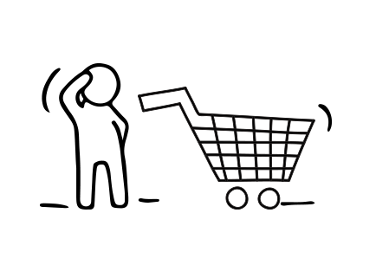
ONLINE MARKETPLACES
Many start up businesses use online marketplaces as a first step when starting to sell online. It is really important you choose the online marketplace most suited to your business..
In this section, you will:
Learn what is an Online Marketplace
Explore the benefits of Online Marketplaces and how they differ from independent ecommerce sites.
Spotlight on the main Online Marketplaces and the Pros/Cons of each
What you need to sell through an Online Marketplace

Slide 22

WHAT IS AN ONLINE MARKETPLACE AND WHY IT MIGHT WORK FOR YOU?
A marketplace is a multi-seller online store that enables consumers to shop for a variety of products and brands from multiple vendors across multiple locations. Thinking of it as renting a place online
The main reason for choosing an online marketplace is the massive audiences that these sites attract.
Think of it like this: if you were given the choice would you set up a stall in a major shopping centre or in a hard-to-find side street?
If you set up away from the main retail street, you would have spend more on signs and marketing to let people know where you are and encourage customers to seek you out.

Slide 23
BENEFITS OF MARKETPLACES
Marketplaces make it convenient for your business to list and sell your products:
People recognize and trust the well-known marketplaces and can buy in the reassurance of their strong customer protection
Online marketplaces can help quickly reach a wider audience with a smaller investment
By using a marketplace, you avoid the need to set up your own shopping cart and payment process
Marketplaces build a community around the common needs of retailers and consumers
While we suggesting you set up your shop on an online marketplace, the benefits of having your own website should not be overlooked. A website will help you build your brand, personalize your offerings, and drive customer relationship and experience.

Slide 24
SELLING ON MARKETPLACES
  Find the best marketplace to sell your products online
  Many business women are successfully selling through online marketplaces. There are many online sales platforms and it is important to find the one that’s right for you:
  Amazon Marketplace,
  eBay,
  Etsy,
  Shopify.

Slide 25
AMAZON MARKETPLACE
The power of the Amazon.com e-commerce platform is hard to absorb. Over 2 million third-party sellers use Amazon Marketplace as the platform to facilitate anyone to sell directly to the end-user or online customer.
Amazon takes a referral fee from each sale. The seller takes on merchandising responsibilities and manages their prices.
FIND OUT MORE
How to start an Amazon Marketplace business
https://startups.co.uk/how-to-start-an-amazon-marketplace-business/

Slide 26
AMAZON MARKETPLACE
Amazon advantages
Amazon has brand name power
Most unique monthly visitors of included marketplaces
Low bounce rate and high daily time on site
Amazon challenges
Free membership features are limited and come with high listing fees
Major competition. Amazon has a lot of merchants you’ll have to compete with.
Depending on the situation, you won’t get your money for 14 to 90 days after selling an item.
Lack of brand development - Individual seller names are not emphasized when purchasing items on Amazon

Slide 27
AMAZON MARKETPLACE
Some selling tips
Think about how you will ship your items. Amazon provides a fulfillment service that many sellers choose to use. Simply ship your inventory to an Amazon warehouse, and when an item sells, they will ship your item. They also take care of returns and customer service.
When the time is right, consider upgrading your membership to unlock extra features. Upgrading will give you access to tools like bulk uploading and enhanced editing.

Slide 28


AMAZON
MARKETPLACE - WATCH
Very practical videos taking you through all the steps to build an Amazon business in 2020 and 2021.
While the video relates to AMAZON UK and DE, the principles apply to all other AMAZON EU marketplaces.
Here is a link to same - Amazon Europe Marketplaces - The Complete List & Overview (sermondo.com)

Slide 29

eBay
eBay.com is an online auction and shopping website in which people and businesses buy and sell a broad variety of goods and services worldwide.
eBay is a contemporary to Amazon and has similar presence on the internet, but the business model is slightly different. It is the largest C2C (consumer to consumer) marketplace on the internet, it provides a possibility to sell nearly anything you want by setting up an auction as well as by a fixed price.
FIND OUT MORE https://sellercentre.ebay.co.uk/

Slide 30
eBay
eBay pros
Users stay on the site for much longer than most other marketplaces
Ebay offers many customization options for listing an item
Auction-style listings can drive higher revenues for sellers
eBay cons
Fee per sale is much higher than almost every other marketplace
Unique visits per seller are very low and customers tend to be looking for lowest price possible
Email support is not available

Slide 31
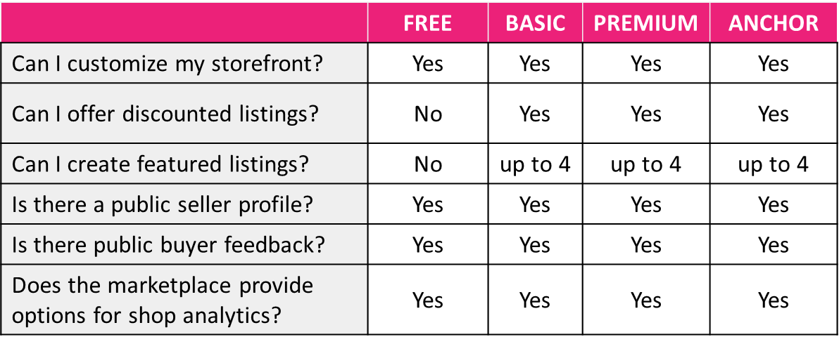
eBay
eBay.com pricing and features overview
Make sure to list your products as “Buy it Now” rather than auction items.

Slide 32

ETSY
  Etsy is the global marketplace for unique and creative goods. It claims to be “a place where creativity lives and thrives because it’s powered by people. We help our community of sellers turn their ideas into successful businesses”. Their platform connects with millions of buyers looking for an alternative - “something special with a human touch, for those moments in life that deserve imagination”.
Etsy pros
Seller profiles and store items are major focus of item listing pages
There are millions of unique visitors each month
Low bounce rate and high daily time on site
Etsy cons
Focused on niche items, but because of seller quantity, items are often overly abundant or impossible to find
High fee per sales accompanied by a moderate fee per listing
Make sure to list your products as “Buy it Now” rather than auction items.

Slide 33

ETSY an example
Franziska Lienberger of Irishfeltfairy, Ireland. Originally from Switzerland, Franziska crafts iittle fairies and leprechauns made from felt.
Her USP: They are one off - each fairy creation is unique!
Where she sells: On her own website
www.irishfeltfairy.com and on Etsy
Which site sells more? Etsy!!
www.etsy.com/ie/shop/IrishFeltFairy

Slide 34
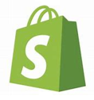
SHOPIFY
Shopify is a unique online marketplace because it’s a website builder, but for ecommerce companies, that want to sell directly to consumer.
For a monthly fee, the advantages of selling on Shopify are:-
Sell on your website versus a marketplace
With Shopify, you get a website built for ecommerce companies. For example, you can choose from ecommerce web design templates, which make creating a website and transitioning to selling your site easier.
Create an online store fast, without a development background
The design templates, both free and paid, available from Shopify make it possible for anyone to launch an online store. Even if you don’t have a development background, you can confidently create and publish a store for your business.
Launch Google and Facebook ads from within the platform
Shopify also includes a built-in feature for advertising your products. Whether you want to launch ads on Facebook or Google, you can do it from within Shopify.

Slide 35

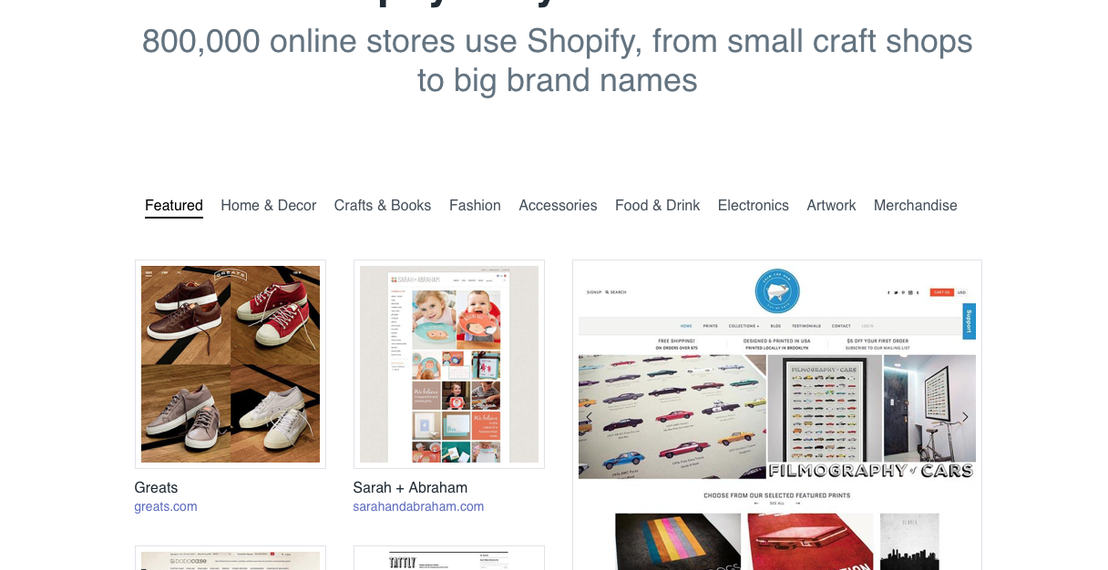
SHOPIFY
Online Stores can be built on Shopify handling everything from marketing and payments, to secure checkout and shipping. Costs from €9/month.
www.shopify.com/examples - examples of Shopify online stores with ecommerce template designs.
CLICK HERE
TO VIEW

Slide 36
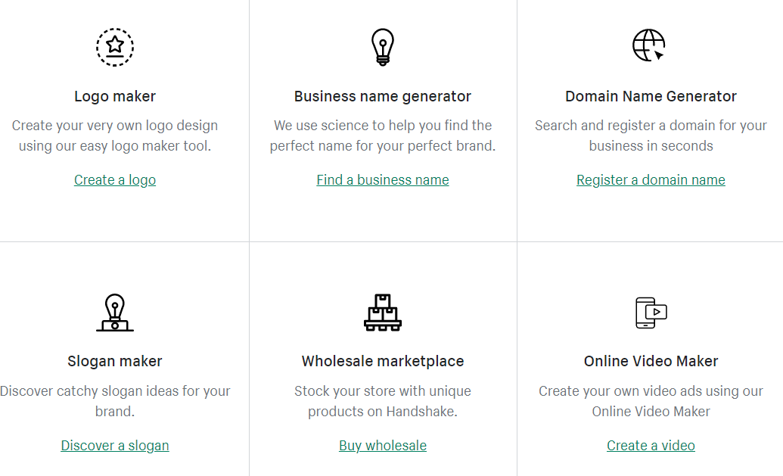
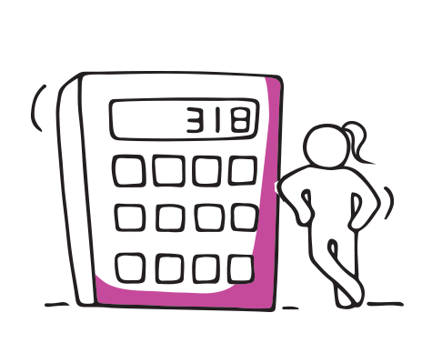
SHOPIFY
There are many tools in Shopify that will help you launch your business.
Free Business Tools - Online Tools for Small Businesses (shopify.com)

Slide 37

FACEBOOK MARKETPLACE FOR BUSINESS
You may be familiar with Facebook Marketplace which lets people buy and sell items like furniture and clothes. While the platform is commonly used by individuals, Facebook has started rolling out Marketplace for Business.
The benefits of Marketplace for Business for start up businesses:-
1. Start listing products for free - Unlike most other platforms, Facebook Marketplace for Business lets you create and manage listings for no additional cost. It is a fast and free selling option.
2. Increase brand awareness- Like it or not, more than 800 million people across the globe use Facebook Marketplace each month — so access to a large audience. Even if your business doesn’t post directly on Marketplace, you can advertise your products on Marketplace to reach more shoppers.
.

Slide 38
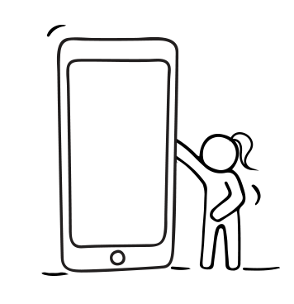
FACEBOOK MARKETPLACE FOR BUSINESS
3. Boost product sales
With Facebook Marketplace for Business, you can list items from your Facebook Page Shop for free. This allows customers to purchase directly on Facebook, without leaving the platform. If you want to sell more online, consider linking your Facebook Page shop with Marketplace for Business to boost product sales.
4. Interact directly with customers via Facebook Messenger
When you sell on Marketplace for Business, you can respond directly to questions from interested buyers on Facebook Messenger. This way you can answer questions in real time and provide the information they need to purchase before they lose interest. People feel more confident in their purchase decisions when they can chat to the business owner.

Slide 39

OTHERS TO CHECK OUT
Goodsie is a simple, stylish and affordable way to create an online store. WATCH Goodsie on Vimeo
Storenvy https://www.storenvy.com is a marketplace and store platform for the world's most unique businesses. Shop thousands of indie merchants or open your own store for free. WATCH How To Set Up An E-commerce Shop | Storenvy Tutorial Guide - YouTube
Bonanza https://www.bonanza.com/ a marketplace built for those who don’t know exactly what they want to buy, but are open to discoveries and the social side of shopping. Buyers and sellers can chat real-time on this site, and everyone can create collections of items of a certain theme, opening new ways both to market your goods and provide great customer service.

Slide 40
ANOTHER WAY TO START A BUSINESS - DROPSHIPPING
Dropshipping is a retail fulfillment method where you doesn’t keep the products you sell in stock.
Instead, when you sells a product using the dropshipping model, you purchases the item from a third party and has it shipped directly to the customer.
As a result, you doesn’t have to handle the product directly.
Benefits
Dropshipping is a good business model for aspiring entrepreneurs to start with because it’s accessible, less capital is required, easy to get started, low overhead, flexible location, wide selection of products to sell, easier to test & easier to scale.
With dropshipping, you can quickly test different business ideas with limited downside, which lets you learn a lot about how to choose and market in-demand products.

Slide 41
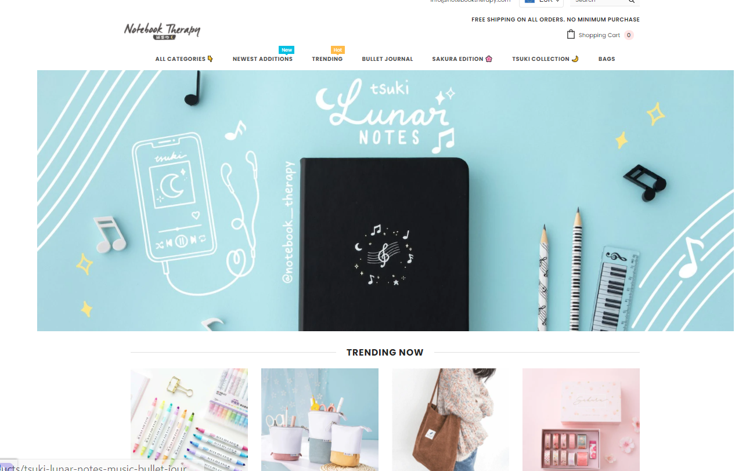
EXAMPLE OF A DROPSHIPPING BUSINESS
NotebookTherapy - Japanese + Korean Stationery Shipped Free Worldwide
NotebookTherapy started with a love of stationery and a life-long affection for East-Asian culture. Inspired by visits to the incredible stationery stores of Korea and Japan, the founders returned home thirsty for more...
They made it their mission to track down most beloved stationery items, make them easily available online and ship them free to stationery addicts over the planet!

Slide 42
WHY ARE NOTEBOOK THERAPY SO SUCCESSFUL ?
They found a trendy niche and a devoted community within it, which has made them a huge success.
What are their success hallmarks?
Unique selling point - Most products have unique appeal.
Clear and simple store - Very easy to navigate with plenty of whitespace. Much of the store uses custom fonts and hand-drawn doodles amidst a pastel colour scheme – perfect for the audience they’re targeting.
Free shipping - Free tracked shipping on all orders.
Social media following - Huge on Instagram and YouTube. Incredible Instagram following – Over 1 million devoted followers who enjoy product updates and short tutorials on cute art creation.
Really good blog campaign – s articles on how to draw certain doodles along with the best types of stationary to use (obviously those that the store dropships).
READ MORE
The 14+ Most Successful Dropshipping Store Examples (pagefly.io)

Slide 43
Start up in business with your own website

Slide 44

IMPORTANCE OF YOUR OWN WEBSITE
The importance of your own website for sales cannot be overstated. By having an online presence through your website, you are able to reach more consumers. But developing a website doesn’t automatically bring paying customers to your business and that is why we started with Online Marketplaces. When you can afford to, set up your own website.
Your own website gives you the freedom to be much more extensive and engaging, since it allows for the inclusion of photos, work samples, and testimonials from happy customers.

Slide 45
SETTING UP YOUR OWN WEBSITE
There two main ways to set your website
Use a website builder.
Create your website or online store using drag-n-drop templates.
This is an excellent review of the top 10 website builder that you can use. They cover all levels of technical ability or you are sure to find one to suit your needs
Website Builders Comparison: Find the Best Site Builder (top10bestwebsitebuilders.com)Builders of 2021
Hire a professional.
If you have the budget, you may prefer to subcontract the creation of your website to professional web designer.
This article sets out 8 tips for hiring a web designer for your business
8 tips for hiring a Web designer for your business | CIO

Slide 46
OPERATIONS – THE ‘HOW’ OF BEING IN BUSINESS

Slide 47
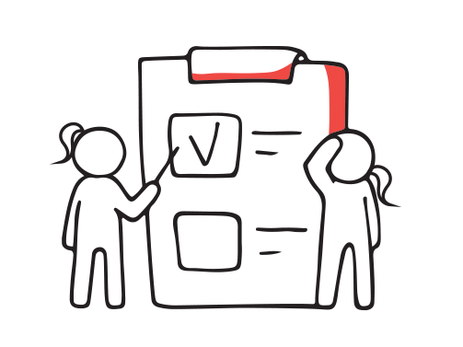
GETTING OPERATIONAL!
This is the practical part of your business planning that deals with the OPERATIONS - the physical necessities of your business's operation, such as your physical location, facilities, and equipment.
You need to consider and make many decisions on many things from sourcing materials and stock, and planning for what is needed in your manufacturing or service process.
In this section, we take you through the key considerations you need to plan for……

Slide 48
WHAT DO YOU NEED IN A BUSINESS LOCATION?
What type of premises will your business need in terms of its size and location? Think about what you need from the building layout in terms of your workflow.
Will you work from home or rent a premises, and at what cost ? What lease agreements are involved? Don’t forget the cost is more than just the rent, you need to think about maintenance, utilities, property taxes, insurance, remodeling, etc.
Do you need multiple locations or locations designed with specific purposes, such as a workshop for manufacturing, admin office and/or a retail sales location.
Access: What type of access do you need for your location? Detail how customers will access your business. Ex. do you need easy walk‐in access?

Slide 49
Some options for your business base
Business Premises & Working Arrangements
Co- Working Space
Virtual Address
Popup Retail Space
A flexible arrangement - you can lease on a rolling basis for a period of days, months and even years. Ideal for digitally-based start-ups with minimal staff, this type of workspace agreement drives collaboration and flexibility while also minimising costs.
Popular for start-ups enabling you to associate yourselves with iconic addresses e.g. The Food Hub. Helps to cultivate trust among customers, also instantly lowering overheads
This structure is completely temporary and can include vacant storefronts, for-rent buildings, or abandoned factories.
READ ABOUT POP UP GALLERIES https://partners.artsy.net/resource/pop-up-galleries/

Slide 50
WHAT EQUIPMENT DO YOU NEED?
Necessary Equipment: What equipment do you need to carry out the basic operation?
Current Assets: You may already have some of the necessary equipment to carry out operations. Make a list and include value
Equipment Priority: Some equipment may be desirable but not a necessity. Decide a level of priority for obtaining it. Give them a higher priority if they are likely to increase production or efficiency.
Equipment Pricing: Outline a cost for purchasing (new or used) or renting the necessary equipment.
Equipment Financing: Research any financing arrangements that you need to put in place for stock, furniture, equipment, and vehicles.
Technology: How will you use technology to reach your goals?

Slide 51
Now, let’s think about producing your product or service
How do you plan to make your product or carry out your service?
EXERCISE: YOUR PRODUCTION PLAN
Write down a step-by step-outline of the production process or service delivery activity from the beginning to the end which is the point you get paid
Outline the day-to-day activity necessary to carry out your business.
Here you should outline the process of making or manufacturing your product. If you provide a service, you should outline all of the moving parts and individuals necessary to carry out the service.
A great way to do this is to create a checklist or flowchart – creating it visually makes it really clear what is involved.

Slide 52
You will need to consider…
Your Supply Chain - A supply chain is an entire system of producing and delivering a product or service, from the very beginning stage e.g. sourcing the raw materials to the final delivery of the product or service to end-users.
Production or Service Timeline - Explain how long it takes to produce a unit or deliver your service. Include any factors that may affect the time frame of production or service and how you’ll deal with potential problems or opportunities, such as delayed supplies, or rush orders.
Production Feasibility – refer back to your Market Research, does you plan meet what the market told you they wanted ?
Vulnerability - You should identify any potential problems or risks that could arise in the production or service process. How will you handle any such issues? What would be the effect on the business?

Slide 53
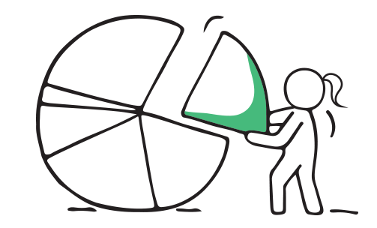
Let’s learn about your SUPPLY CHAIN
You need to be very clear on your SUPPLIERS (the start of your supply chain) and storage of raw materials – the materials or substances used in the making of your product – e.g. a baker needs flour, eggs, packaging – all of which need to be sourced from different suppliers.
Supplier Background: You need to research your suppliers carefully. Check our all background information on the supplier, not only their prices, other aspects are their reliability of supply, credit terms. You need to have confidence in the stability/dependability of their service. Reliance on one sole supplier is also risky so have alternatives available to you.
Details of Supply: Put in writing the type, amount, and cost of the supplies from each supplier. This should include a description of any anticipated fluctuations in the requirements or costs of the inventory. For example, you will want to outline the spikes in seasonal demand.

Slide 54
STOCK AND MATERIALS
What you need to consider
Stock Turn-Over: At what rate will you need to restock your supplies? This is an important figure used in assessing the sales strength of your business.
Special Stock Requirements: Do you have a plan for dealing with stock requirements seasonally ? This includes a plan for lead-time ordering.
Stock Control: You will have to establish a plan for monitoring and controlling stock. Do not forget stock = your cash so be very careful to manage this very tightly.

Slide 55
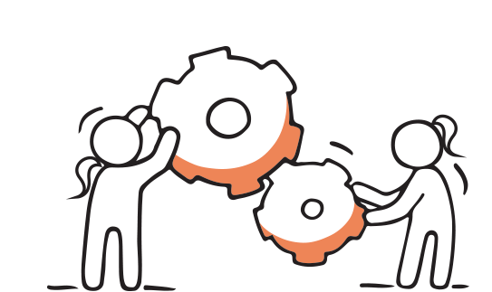
STOCK AND MATERIALS
What you need to consider
Payment Terms: Be very clear of the basis of the supplier-purchaser relationship. What are their terms of payment?
What are their terms of delivery?
Back-Up Plan: It is important to have a back-up plan in the event you lose a supplier or the supplier is unable to meet your requirements. This could include options of alternative suppliers.

Slide 56
AN EXAMPLE OF A SUPPLY CHAIN FOR A SWEATER
Farmer shears the sheep and yields a woolen fleece.
Wool is transported to woolen mill who prepares the fleece and converts into wool.
The mill sells the wool to a wholesaler or directly to you.
The wool is delivered to you and you create the garment.
You sell the sweater to a shop or directly to a consumer. Delivery happens and you get paid.

Slide 57

Product or Service Workflow
To put it simply, a “ workflow ” is how you get work done. It’s a series of tasks you need to complete in order to reach some repeatable business goal. The key word here is repeatable.
Put your workflow on paper….
Do a step-by-step description of how your product or service will be made
Identify any problems that may occur in the production/service provision process and what you can do to negate these risks.

Slide 58

QUALITY – a high priority
No matter how small your business, quality has to be a very high priority for you.
When customers feel that they can count on the consistent quality of your products, they're more likely to give you their repeat business. Consistent quality takes hard work, attention to detail and systems for monitoring and assessing whether your products meet the standards you have set.
Quality control is an ongoing process that touches everything from purchasing to manufacturing to distribution.

Slide 59

Wonderful service, I will be back!
Customer Service
Hope you are happy with our service
What level of customers service will you provide ? Be very clear from the outset, what makes your service so extraordinary ?
What is your plan for customer service? This includes sales communication, return products, and customer follow-up.
Hours of Operation:
Indicate and give a justification for your intended hours of operation. Does your location support these hours of operation? E.g. Julie’s Sweaters intends to operate Monday thru Friday from 9 am to 5 pm. and will be open year-round. Being self employed does give you flexibility of time, but you will achieve more with defined hours of business. It also gives clarity to customers.

Slide 60
Terms of Business - – what you need to think through
This is a really important area to get right from the start. Your terms of business outline the important details that you share with customers before they purchase to ensure mutual understanding.
Sometimes called T&C - terms and conditions – they cover
PAYMENT TERMS - your decisions on when a customer pays- is it on a prepayment basis, cash on delivery, 15- or 30-days credit, any late payment penalties ?
DELIVERY ARRANGEMENTS - free delivery or delivery costs ?
GUARANTEE - on your work offers reassurance, even if it is broad. E.g. we offer a 30 day money back guarantee on all nonperishable items. Perishable items may not be returned.

Slide 61
Terms of Business – what you need to think through
DELIVERY TIMELINES – Set out your expected dates of delivery from the time of order
REFUND OR RETURN POLICIES –
      Ecommerce sites usually give this policy its own webpage. If you sell products online, you can place these policies in your T&C too.
      Retailers normally maintain separate return or refund policies.
      For service businesses, a return or return policy depends on your service
PRIVACY STATEMENT - If you handle personally identifiable information, you need a Privacy Policy. It is still recommended to reference confidentiality in your T&C, but you'll still need a separate Privacy Policy as well. This section does not have to be long. At the very least, provide a link to your Privacy Policy or refer to it if your agreement is not provided online.

Slide 62
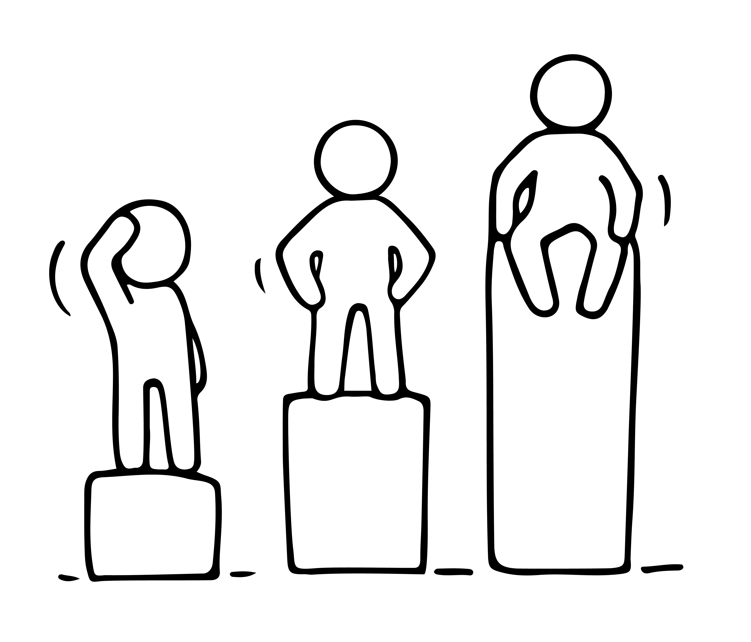
Need help?
While you may be setting up your business as a one woman show, you may need to plan for taking on key staff to help you in the business. This might be a staff member or a freelancer or independent contractors to help you carry out business functions.
If you need staff from the outset, think about your Startup Team:
Who is part of your startup team?
What will be their primary area of responsibility? Describe what you understand their role and duties to be and explain how they are qualified or competent for these duties.
What will they cost your business and can you afford to take them on ?

Slide 63
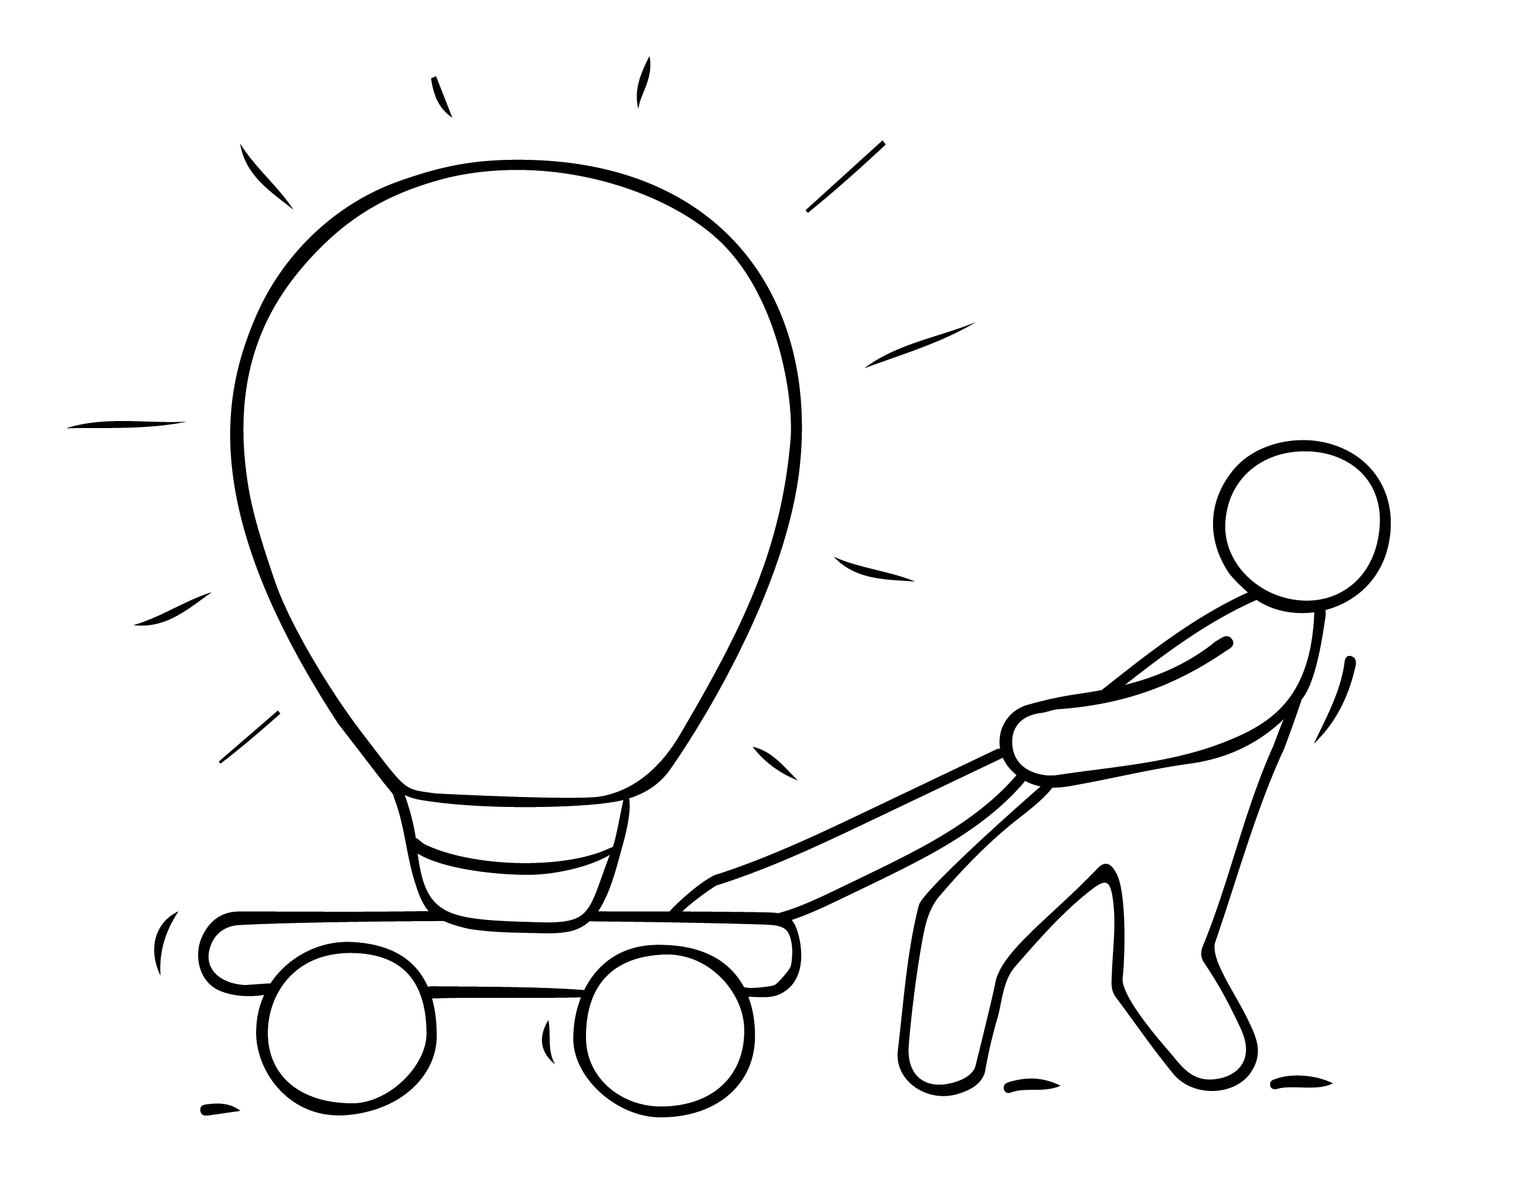
The Legal Part of Getting into Business

Slide 64
Choosing how you set up your business is an important step..
In this section, we introduce you to key enterprise structures and your options. It is important you understand the laws at local, state, and federal level when setting up your new business.
Business ventures can be structured in several ways, but typically there are three legal forms.
Sole Proprietorship
Partnership
Limited Company
We then introduce you to some interesting and emerging business structures.

Slide 65

SOLE TRADER
A sole trader is a person who is the exclusive owner of a business, entitled to keep all profits after tax has been paid but is also liable for all losses.
This person owns and runs the business in which there is no legal distinction between the owner and the business entity.
Sole Traders are personally liable to the debts of your business. Therefore, your personal assets, such as your house and car, can potentially be used to pay your creditors.

Slide 66
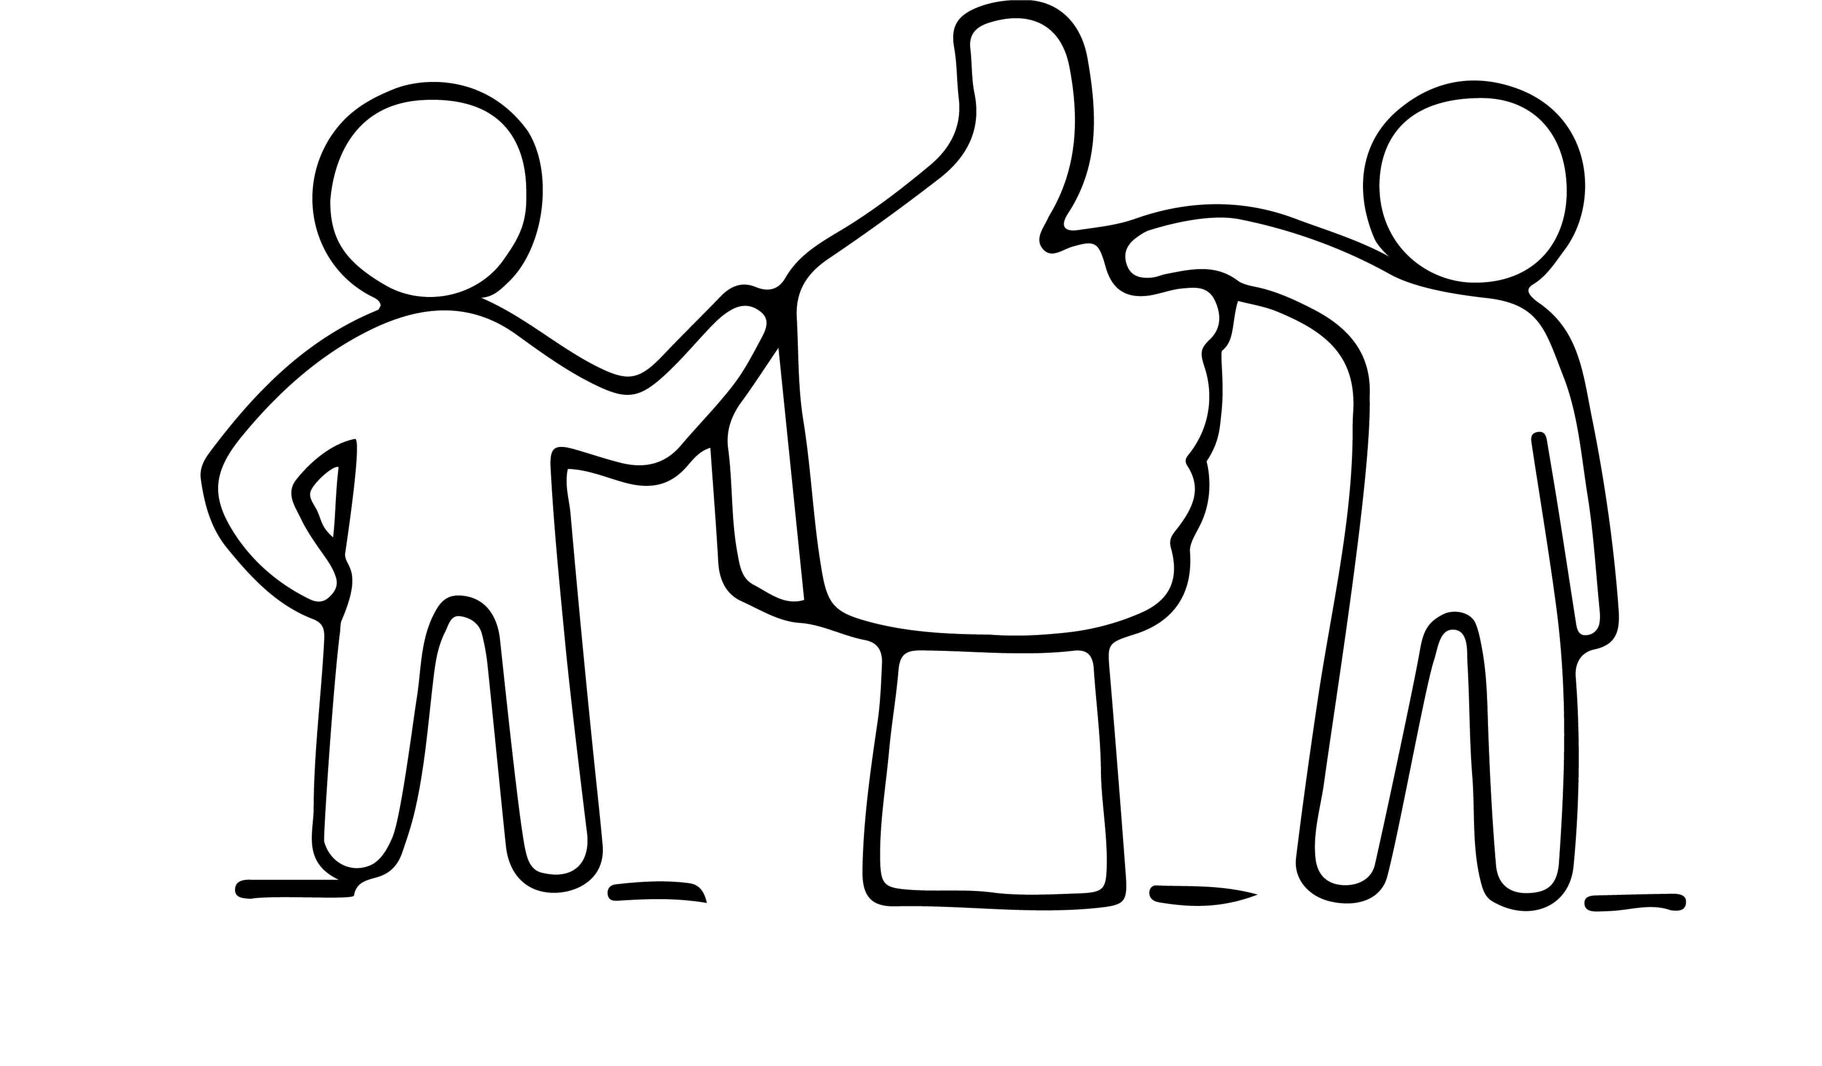
PARTNERSHIP
Partnership is an "association of two or more persons to carry on as co-owners of a business for profit."
Frequently, you may decide to take on a partner because they has skills or expertise that you may lack.
However, take special care in choosing a suitable partner. Don't select the first person that offers to make an investment in your company.
A partnership is a marriage in many ways; take the time and put in the effort to pick a partner. Many businesses has had to close its doors because the business union did not work.

Slide 67
LIMITED COMPANY
Limited Companies are separate legal entities. This means that your potential creditors can only claim against the assets of your company.
ADVANTAGES
Limited Liability protects the personal wealth of a private company’s shareholders and does not put personal assets at risk
Company directors can avail of excellent tax breaks or pensions
DISADVANAGES
Increased legal compliance; file annual returns, get accounts audited, tax and labour laws are also applicable
Requires a minimum of two persons; to act as director and shareholder so personal control is limited.

Slide 68
SOLE TRADER VS PRIVATE LIMITED COMPANY
SOLE TRADER
All your profits are taxed as your income
Personally liable for debts
Lower tax credit than employees
You still need to prepare a tax return each year
Simple to set up & shut down
Less legal filings compared to a Limited Company
PRIVATE LIMITED COMPANY
More corporate filings and deadlines
Large fines and penalties for non-compliance
Longer and more expensive to set up than a Sole Trader
Low tax rate of profits
More tax reliefs and benefits
Credibility for funders
Protection of private assets

Slide 69
INTERESTING WAYS TO GET INTO BUSINESS
Here are some interesting business structures that may support your start up in a more creative way:
Social Enterprise
Community Enterprises
Collectives
Social Innovation

Slide 70
FRANCHISE
A franchise is a business opportunity that allows the franchisee (you) to start a business by using someone else's (the franchisor's) expertise, ideas, and processes.
You pay a franchise fee and you get a format or system developed by the company and the right to use their name for a specific number of years with their assistance.
Franchising is seen by many as a simple way to go into business for the first time. But franchising is no guarantee of success and the same principles of good management - such as informed decision-making, hard work, time management, having enough money and serving your customers well - still apply.

Slide 71
ADVANTAGES AND DISADVANTAGES OF A FRANCHISE
ADVANTAGES
Benefits of a small business ownership; supported by benefits of a business network
Training provided to run; don’t necessarily need business experience
Higher rate of success; compared to a start up
Secure finance may be easier; may cost less than to start yourself
Established reputation and image; proven management and work practices and ongoing support
DISADVANTAGES
Costly Investment: start up cost varys depending on the type of business and industry demand.
Cannot exceed to other geographic areas; can diminish potential growth
Strict Operations Guidelines; you have to follow for managing, marketing and operating
Risk Reputation; if the brand gets a bad reputation because of other locations
Limited Exit Strategy; there are strict rules, must get approval

Slide 72
BE AWARE, BE PREPARED- REGULATIONS
Taxation: Registering for tax, sales tax registration and withholding, property tax, etc., make sure you are fully aware of your obligations.
Protecting Intellectual Property: Depending on your business, you may need to develop a plan for protecting and maintaining all applicable forms of intellectual property, including trade secrets, trademarks, copyrights, and patents. In some cases, protecting your intellectual property can be very costly (such as patent filings). Account for these costs within your financial plan – Module 6.

Slide 73
BE AWARE, BE PREPARED- REGULATIONS
Licences- Some trades/sectors require permits or licences to operate e.g. street traders and waste management If you are in the food or cosmetics sectors, ,there are dedicated regulatory authorities with whom you have to register and comply to their standards.
Health and Safety- If you are offering a service to customers e.g. hairdressing, gardening, you will be responsible to ensure that you meet safety in the workplace legislation. Outline a plan for the necessary workplace inspections and standards. These standards can drastically affect your construction plans and applicable costs. Environmental regulations include proper documentation and accountability for waste, waste and environmental surveys of the location, etc.
Employment Laws: Develop a plan for legal compliance with all employment laws.

Slide 74

Next.. Step 4
Enjoyed learning about Step 3?
Join in the conversation with your peers on our EMINENT Closed Facebook Group
A safe place to talk about your opportunities and challenges, excitement and fears.

