Slide 1

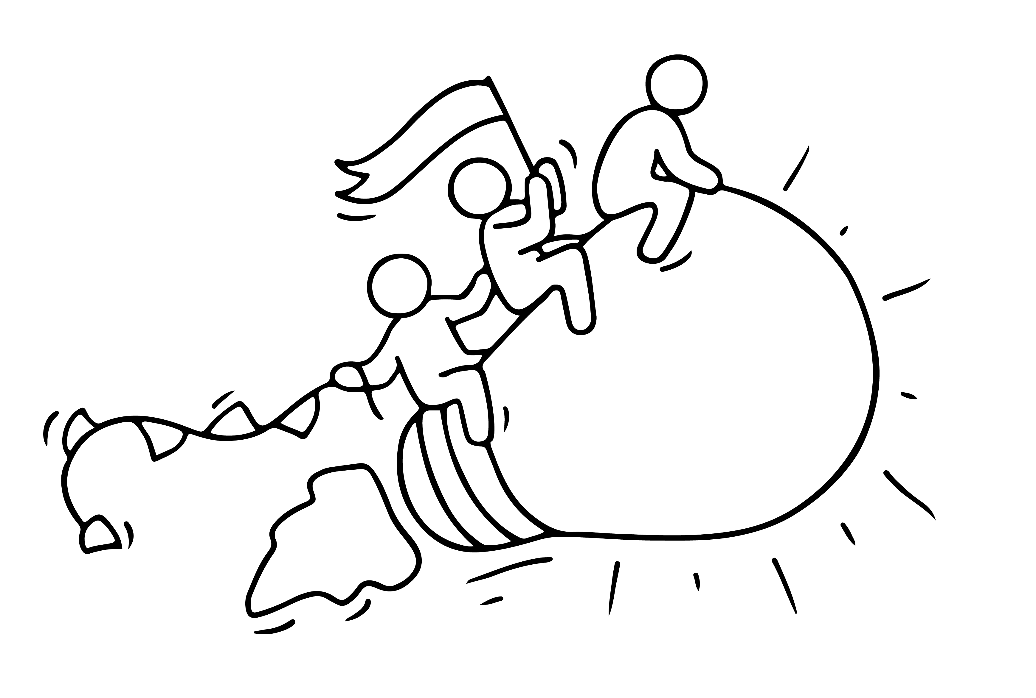


STEP 5
THE POWER OF COLLABORATION and NETWORKS
“Alone we can do so little. Together we can do so much.”
Helen Keller
This programme has been funded with support from the European Commission
This project has been funded with support from the European Commission. This publication [communication] reflects the views only of the author, and the Commission cannot be held responsible for any use, which may be made of the information contained therein.

Slide 2
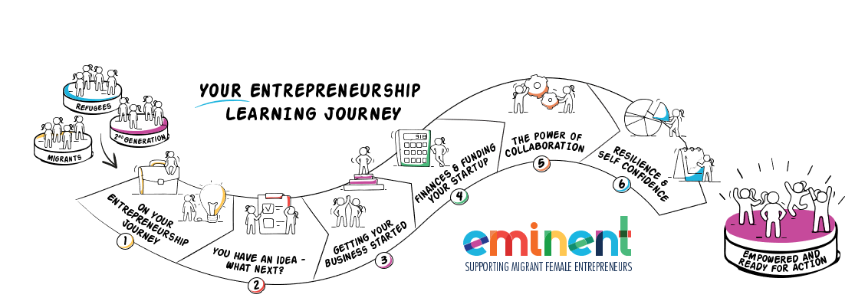
EMIMENT wants to enable Female Migrant Entrepreneurs. We want to bring you on your learning journey to gain the knowledge and skills you need to gain the confidence to establish and successfully run your own business.
Can you? Of course, you can. Open your mind and let us bring you on Your Entrepreneurial Learning Journey…….

Slide 3
IN STEP FIVE, YOU WILL LEARN
PAGES
What is collaboration and why is it important to you? The value of collaboration 4 -9
6 ways collaboration will help you in your business 10 -15
How to be a great collaborator 16 - 27
6 steps to collaborate successfully 28 - 29
Finding people to collaborate with 30 – 33
Tips and tools for successful collaborations 34- 37
Networking, what is is and overcoming barriers 38 – 48
Relevant European Networks for female entrepreneurs 49 - 51
"If I have seen further it is by standing on the shoulders of Giants.“
Issac Newton

Slide 4
WHAT IS COLLABORATION AND WHY IS IT IMPORTANT TO YOU?
Collaboration is a popular buzzword these days but it is a really powerful business approach that will help you on your way.

Slide 5
WHAT IS COLLABORATION?
Collaboration is the process of two or more people or organisations working together to realize mutual advantage. It is a powerful business tool, regardless of the size of your business or the industry you are in. In practice, it is about working together to address problems and achieve goals that seem to be out of reach when working alone.
Options range from informal networks and alliances, through joint delivery of projects to a full merger. ​
Collaboration begins with mutual understanding and respect.
“If you want to go fast, go alone. If you want to go far, go together.”
African proverb

Slide 6
Collaborating with others can provide you with the additional skills and resources to do things that you couldn’t achieve on your own.
This could be anything from developing a new product or using new material in your design process, to securing a new client or gaining access to significant funding.​
Getting collaboration right though, takes effort and a culture open to change. Collaborations require serious effort to make the collaboration work.
​

Slide 7
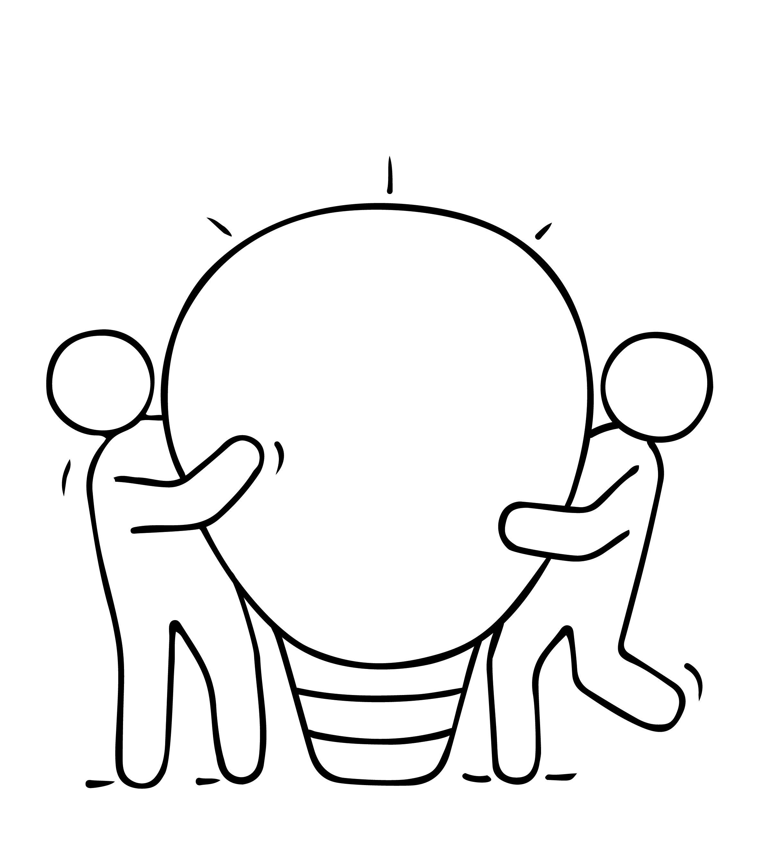
THE VALUE OF COLLABORATION
We know the saying - a problem shared is a problem halved.
​
Research shows that discussing problems with people in similar situations reduces stress levels. Problems don’t seem as overwhelming when you talk about them, and two people are more likely to find
a solution than one.​
Read more: www.dailymail.co.uk/sciencetech/article-2548917/A-problem-shared-really-IS-problem-halved-Study-finds-discussing-problems-people-situation-reduces-stress-levels.html ​

Slide 8
THE VALUE OF COLLABORATION
When you bounce ideas off someone, or lean on someone for their ideas and critiques, you magnify your own abilities in several ways.​
Momentum: Someone else is supporting you to move to the next step​
Sources: You add more ideas to project, more research, another lifetime of knowledge​
Perspective: You see angles and flaws you would not have seen yourself
Speed: You are able to work faster, identify the be ideas more quickly​
Decisions: A sounding board helps you talk through your own decisions, understand your own thinking more easily. ​
Validation: A good collaboration partner not only sees the flaws in your work, but can help support your best ideas and spur you forward in the right direction.​

Slide 9
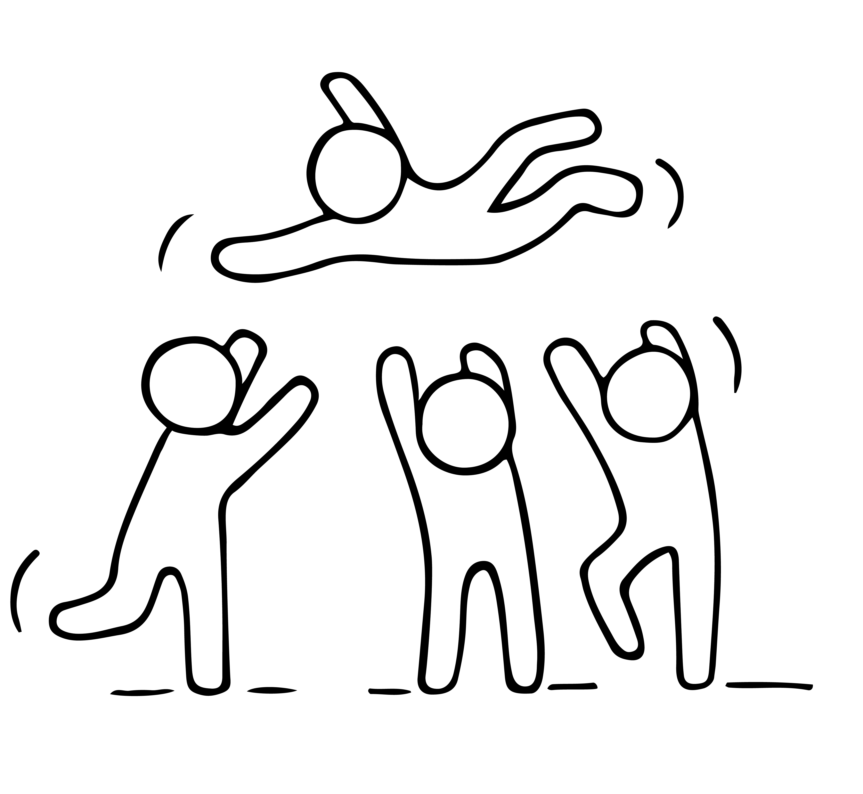
WHY COLLABORATE?
“A great partner lets you soar without drifting away.
Sometimes they are the ​ wind that’s hoisting you up. Sometimes they are the ones
on the ground, holding the
kite string. We need to play all of these ​roles for each other.”​
​
Source: http://www.flightofideas.net/Articles/Dynamic%20Duos%20-%20the%20Power%20of%20Creative%20Partnerships%20-%20Summer%202006.pdf ​

Slide 10
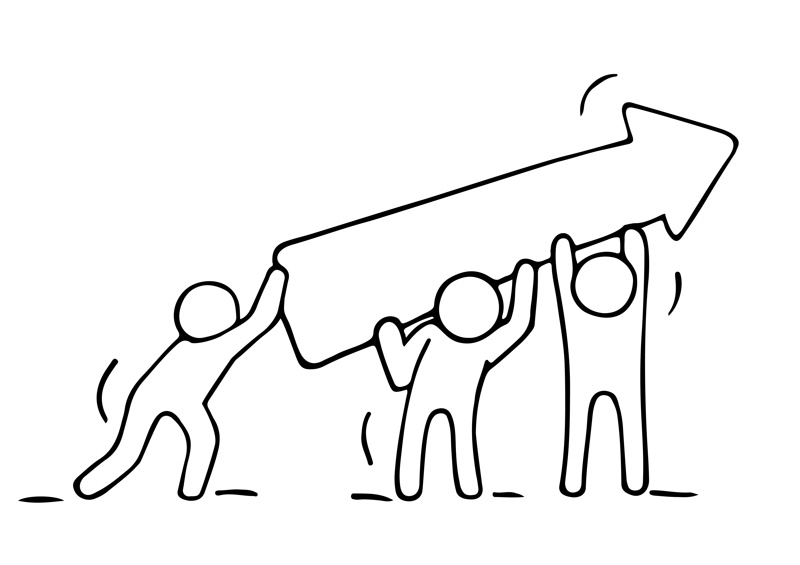
6 WAYS COLLABORATION WILL HELP YOU IN YOUR BUSINESS
The connections you form with others, and the different ways you collaborate will help you grow your business to new levels. There are
1. Collaboration Will Inspire You
It is easy to get into a routine during the day-to-day operations of your business and forget that there may be a better way to do something, different techniques to try, and new tools that can save you time and money. Collaborating with others gives you a fresh perspective, triggers your creativity, opens up objectively, and adds new context that goes beyond what you do and see each day. It helps you think in a new way.

Slide 11

6 WAYS COLLABORATION WILL HELP YOU IN YOUR BUSINESS
2. Collaboration Helps You Grow Your Network
Successful entrepreneurs have a common interest in meeting new people and building a list of contacts and colleagues. For migrant women entrepreneurs this can be more challenging. Being successful in business requires that you consistently make connections and form alliances. Imagine how your business would dwindle if you continued to network with and sell to the same group over and over again.
While every contact you make may not result in collaboration, every time you reach out to someone to explore the possibility, you are expanding your network.

Slide 12

6 WAYS COLLABORATION WILL HELP YOU IN YOUR BUSINESS
3. Collaboration Is Educational
One of the biggest benefits of collaboration is the opportunity for learning. In fact, every interaction you have with someone outside of your immediate circle can teach you something valuable.
Some of the most successful collaborations involve two professionals who bring two very different skill sets, perspectives, and strengths to the table.
When this happens, you are certain to be surrounded by learning opportunities.

Slide 13

6 WAYS COLLABORATION WILL HELP YOU IN YOUR BUSINESS
4. Collaboration Can Help You Save Money
Many collaborative relationships can save expenses. If you collaborate with another business in sharing costs such as marketing expenses, you can double your budget while reducing costs.
For example, a company might share a trade show stand with a complementary partner, then co-market their participation. This can attract more customers and enhance the experience visitors have to your stand.

Slide 14
6 WAYS COLLABORATION WILL HELP YOU IN YOUR BUSINESS
5. Collaboration Solves Problems
There is a reason crowdsourcing is so popular; there is an undeniable power in numbers. If one person can't accomplish something on her own, two or three or more people may be able to get it done.
The harder the problem is to solve, the more we can benefit from getting the input of someone outside of the situation. And when you add new viewpoints and experiences to the mix, the end result will often transcend what you originally set out to accomplish.

Slide 15
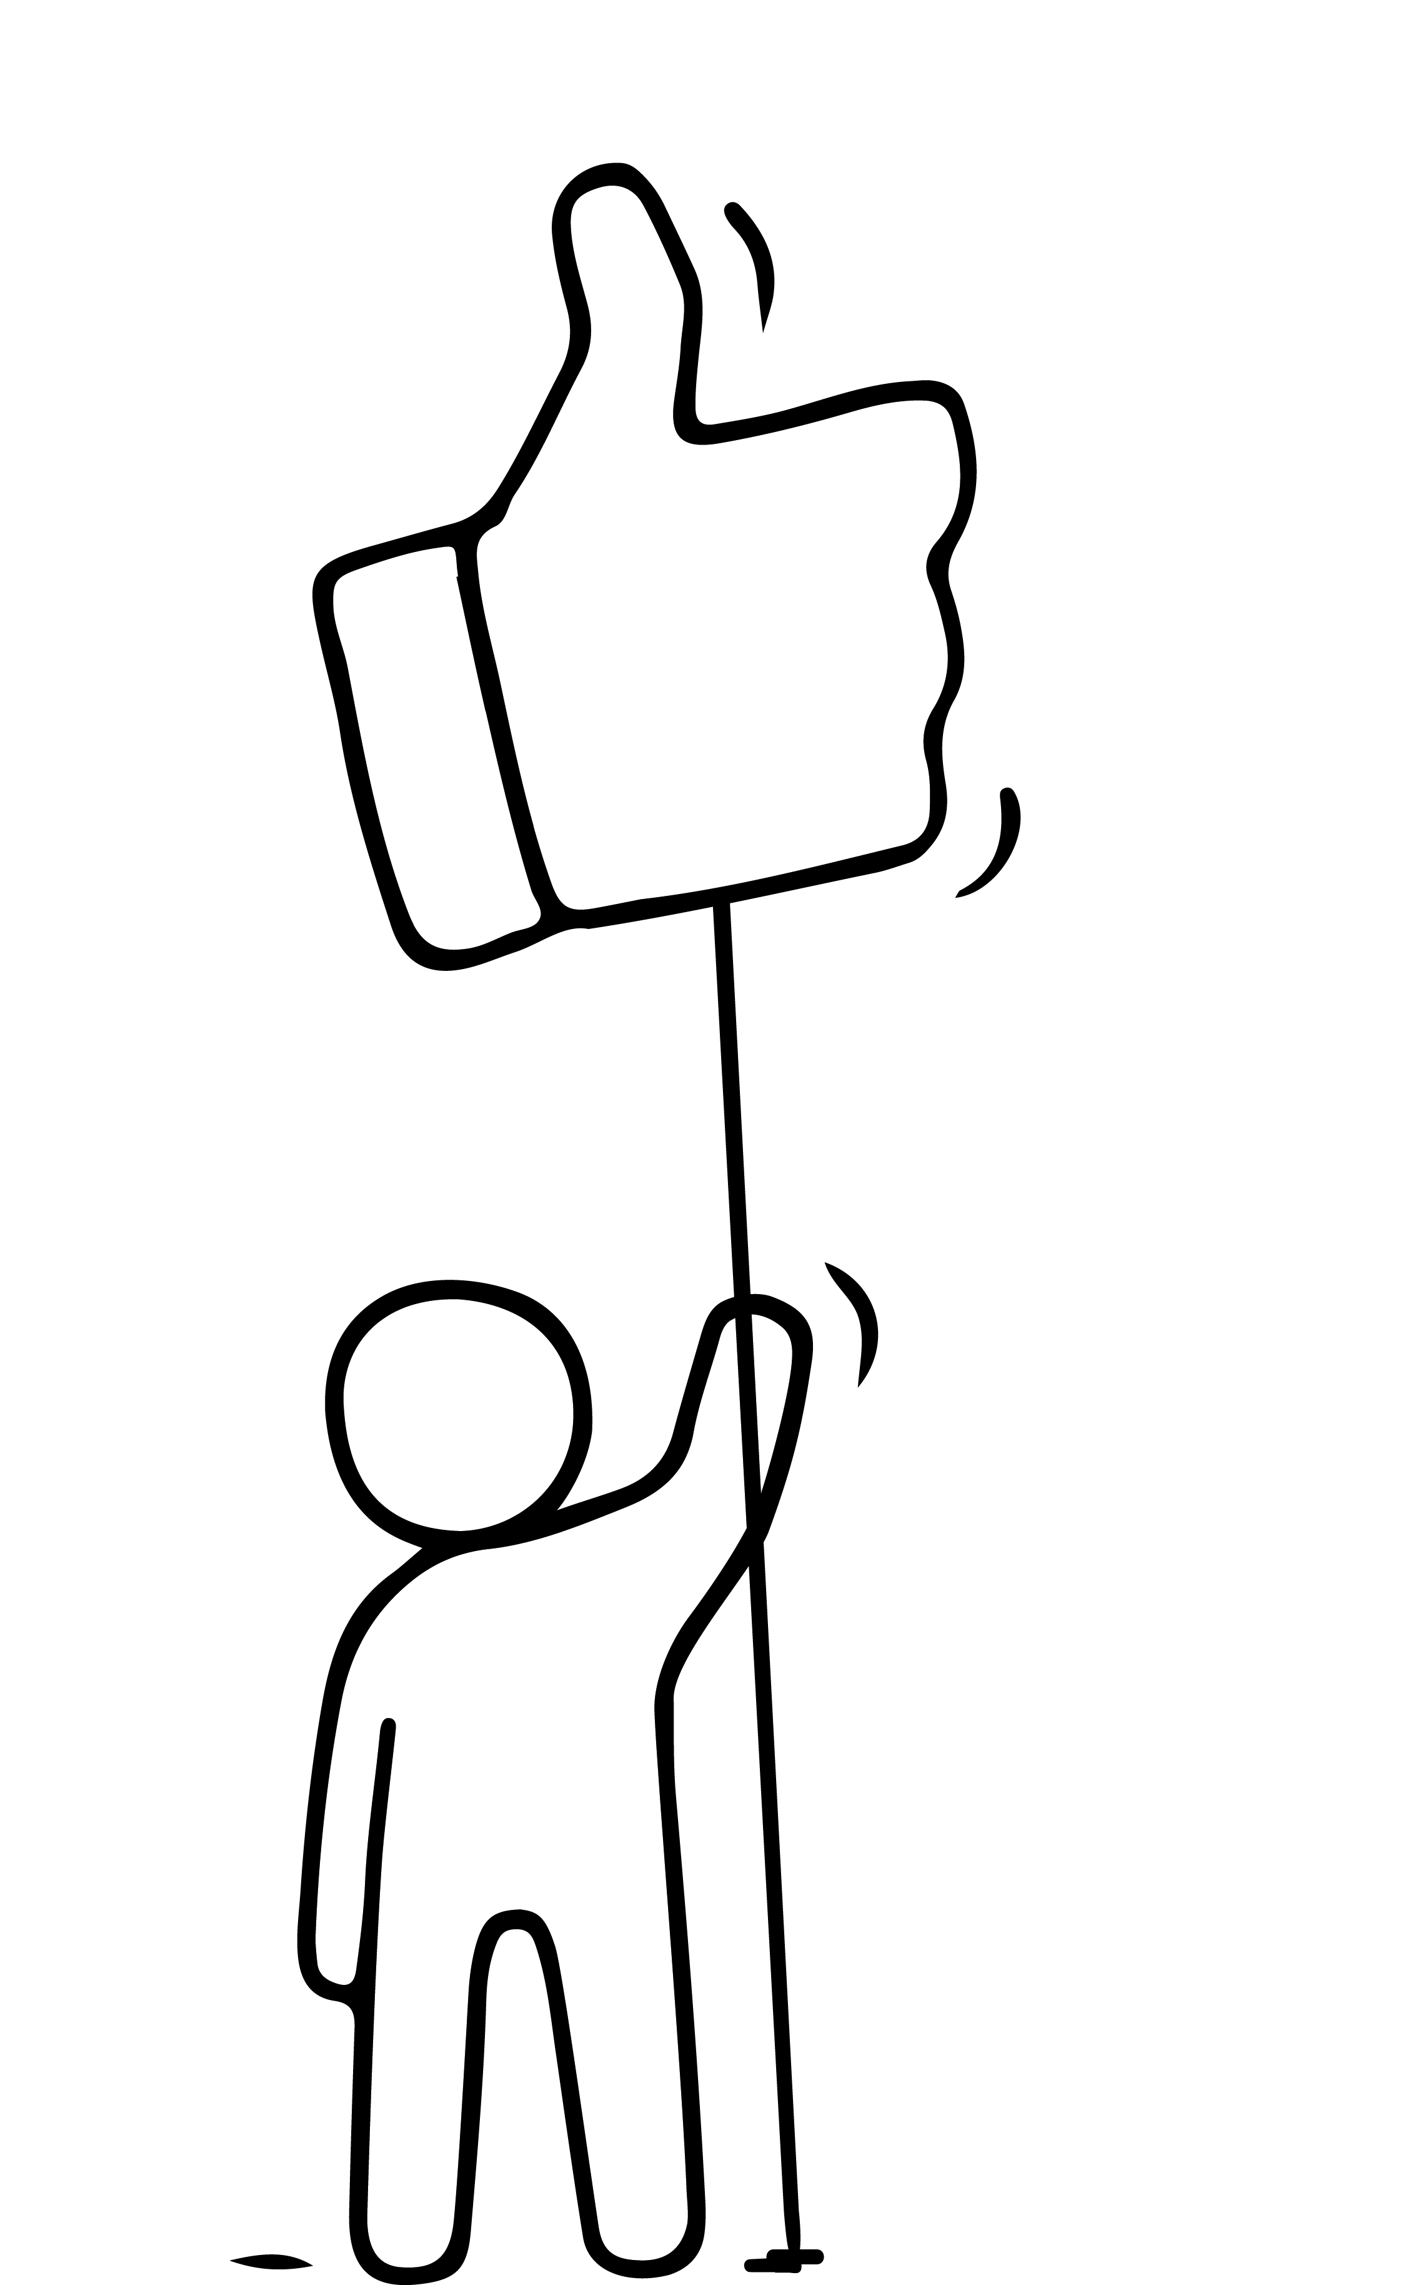
6 WAYS COLLABORATION WILL HELP YOU IN YOUR BUSINESS
6. Collaboration in Action Is Win-Win
A coffee shop places a fresh floral display at its entrance, giving promotion to the florist a few doors down while enhancing the ambiance of its establishment at no cost.
This is WIN WIN.

Slide 16
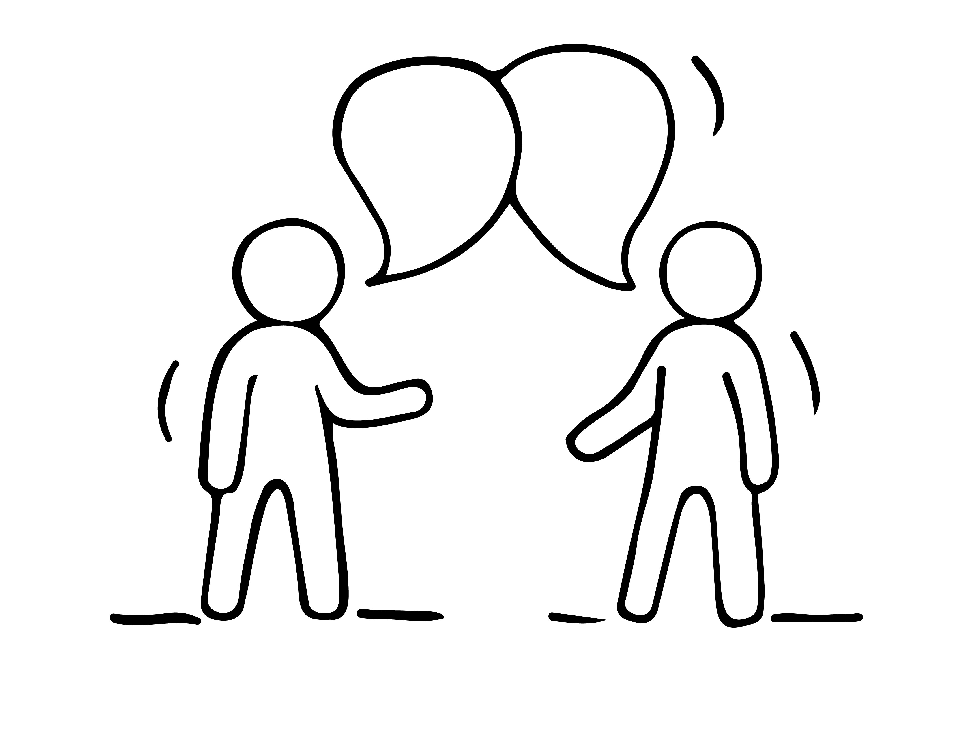
HOW TO BE A GREAT COLLABORATOR

Slide 17
STARTING WITH YOU - HOW TO BE
A GREAT COLLABORATOR: ​
You recognise that working well together and sharing knowledge will help achieve much more than you could create on your own.​
​You approach collaboration with a creative problem solver outlook​.
You value diverse viewpoints, the expertise of others, and communicate well to get the job done.​
​You take pride in your own work and are keen to develop.

Slide 18
TOP 8 CHARACTERISTICS OF A GREAT COLLABORATOR
1. Team focused - To successfully collaborate, you need to be a team player and think about "we" rather than "I". A great collaborator is mindful of shared goals and group success.​
​2. Generous - A great collaborator is willing to take the first step and pitch in, even if they won't get the spotlight. Generosity is also an incredibly desirable leadership characteristic.​
3. Curious - Great collaborators are good at asking the right questions. They don’t interrogate; they simply follow their natural curiosity because they want to understand.​
​
Source: www.samepage.io/blog/10-top-qualities-great-collaborator ​

Slide 19
TOP 8 CHARACTERISTICS OF A GREAT COLLABORATOR
4. Appreciative - The best collaborators express sincere appreciation for all that team members have contributed. They’re not shy about expressing this appreciation and they give credit where credit is due.
5. Listens to understand - Great collaborators listen attentively
to what is being said. But more importantly, they listen
to understand. ​
6. Gives and expects trust - More than anything, highly successful collaborations are built on safety and trust. Great collaborators help create and maintain that trusting environment. They give their trust freely and expect to receive trust in return.
Source: www.samepage.io/blog/10-top-qualities-great-collaborator ​
​

Slide 20
TOP 8 CHARACTERISTICS OF A GREAT COLLABORATOR
7. Builds relationships; breaks down walls - Collaboration is all about working together. Great collaborators see the value in being usually well connected and work hard to build and maintain relationships with others.​
8. Diplomatic - The best collaborators are diplomats. They know that relationships are built on mutual respect.
​
Source: www.samepage.io/blog/10-top-qualities-great-collaborator ​

Slide 21
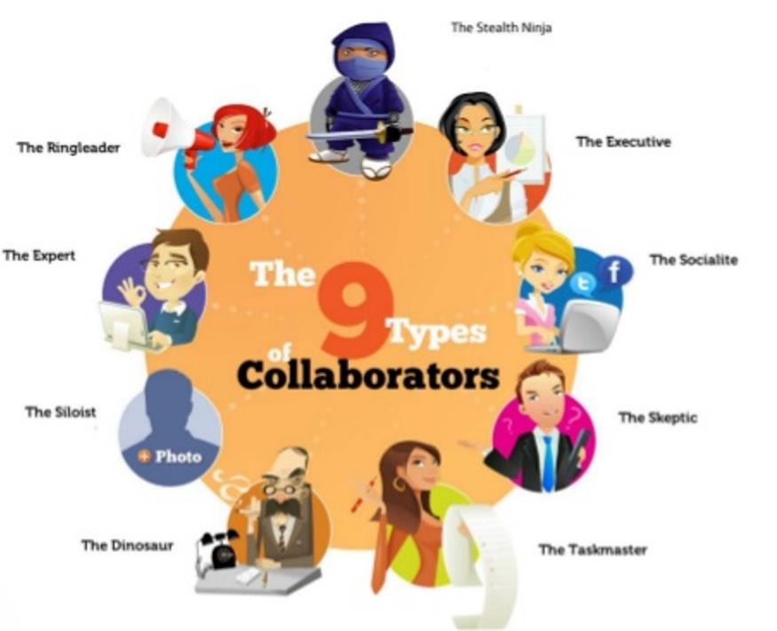
TYPES OF COLLABORATORS​
WHICH ONE DO YOU THINK YOU MIGHT BE?​

Slide 22

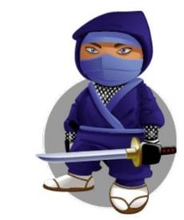

TYPES OF COLLABORATORS - PURPOSE
DRIVEN USERS​
Decision maker that is driven by time, speed and efficiency.
The Executive​
Likes to lay low and oversee without too much involvement​.
The Stealth Ninja​
Loves being organised, is operational focused and keen to get things done, loves lists and action plans​.
The Taskmaster​

Slide 23



TYPES OF COLLABORATORS - POWER USERS​
The Big ideas person, discussion starter and collaboration initiator, lots of creative energy.​
The Ring Leader​
Borderline geek, loves trying and mastering, new and innovative ways of working.
The Expert​
Natural storyteller and connector, great communication skills and is used to social conversations on Facebook, Twitter etc.
The Socialite

Slide 24



TYPES OF COLLABORATORS - RELUCTANT USERS
Enjoys working alone, often reluctant
to​ share work in progress, likes to
hoard information.
The Siloist​
Creature of habit, not keen on trying​ new things, takes encourage to
embrace​ new tools.
The Dinosaur
Can be very vocal opponents to collaboration, often focus on the WIIFM (what’s in it for me?) mentality.
The Skeptic​

Slide 25

EXAMPLE OF COLLABORATION: MIGRANT WOMEN LEADING ENTERPRENEURSHIP
Furkan Karayel
Her story is all about women-in-tech, diversity and female entrepreneurship.
She founded Diversein after spending more than 10 years in tech companies as a software engineer.
After long considerations, she found herself in another journey where she was in minority again and yet this time, with so many unknowns: Entrepreneurship.
Source: https://www.diversein.com/copy-of-about

Slide 26
EXAMPLE OF COLLABORATION: MIGRANT WOMEN LEADING ENTERPRENEURSHIP
Furkan Karayel
Her motto in life is:
​"Discover, share and inspire!"
​
In the last 2 years, she spoke at more than 60 conferences, workshops, events or podcasts about women in tech, women in leadership, female entrepreneurship issues as well as the power of diversity and inclusion at workplace.
Source: https://www.diversein.com/copy-of-about

Slide 27
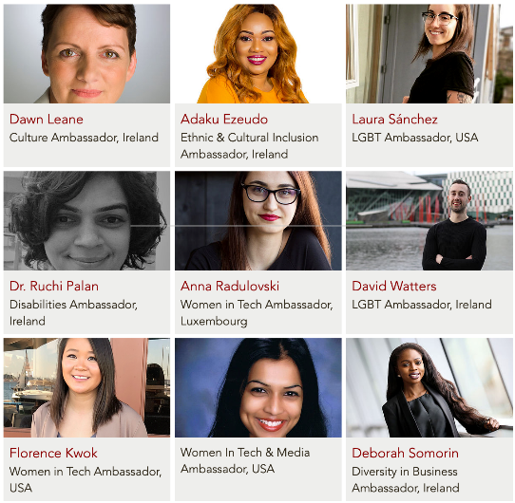
EXAMPLE OF COLLABORATION: MIGRANT WOMEN LEADING ENTERPRENEURSHIP
Furkan Karayel
She collaborates with all these ambassadors to deliver a wider scope of services
Source: https://www.diversein.com/copy-of-about

Slide 28
6 STEPS TO COLLABORATE SUCCESSFULLY ​
Select collaborators ​- Enlist collaborators with little overlap with your fields of expertise, this will ensure each collaborator has a unique contribution to make.
Clarify roles ​& relationships​ - Confusion or doubt about who has what role is the usual source of tension and conflict in a collaborative project. This frequently leads to miscommunication and flawed outcomes.
Set up clear communication paths ​- Communication is central to collaboration because creative dialogue sparks ideas that the participants would never have had on their own.​

Slide 29
6 STEPS TO COLLABORATE SUCCESSFULLY ​
4. Foster open communication​ - The trust built up in a good collaborative circle gives everyone the confidence to advance an incomplete or inadequate thought, knowing that it may catalyze other ideas in the conversation.​
5. Record your ideas - Document profusely: keep your post-its, flip charts, diagrams, and notes. But bear in mind that every so often it's helpful and healthy to erase the whiteboard and fill it back up from memory.
6. Set up clear communication paths​ - Communication is central to collaboration because creative dialogue sparks ideas that the participants would never have had on their own.​
Adapted from Helsinki Design Lab, 19 rules of thumb for creative collaborations and the practices that enable them: http://www.helsinkidesignlab.org/pages/creative-collaborations ​

Slide 30
FINDING PEOPLE TO COLLABORATE WITH

Slide 31
FINDING PEOPLE TO COLLABORATE WITH
FRIENDS FIRST​
If you are seeking the perfect collaboration partner, look first among your friends. Friendship is a very common and solid foundation for a good creative partnership. ​
While some people argue against mixing business and friendships. The late Jim Henson, creator of the Muppets, was a strong proponent of working with friends. “When you work with your friends,” said Henson, “it doesn’t feel like work at all. It feels like fun. I like to work with people I know and trust. With them, the ideas come naturally.” ​
​

Slide 32
FINDING PEOPLE TO COLLABORATE WITH
UNITY OF PURPOSE
Never underestimate the power of common goals. They can move mountains…even when collaborators are distant from each other. ​
The key to the success is that each collaborator needs to have an extraordinary singular focus…a driving force…a common goal. This overriding unity of purpose is essential to any solid collaboration partnership.​
Great collaborations are based on communication, trust and respect.
​

Slide 33
FINDING PEOPLE TO COLLABORATE WITH
YIN & YANG​
In most collaborations, partners are more different than they are similar. They each bring unique skills to the table and they display very divergent thinking and personalities.
While this may seem like a recipe for disaster, it has just the opposite effect. Great collaborators know how to celebrate their differences.
​

Slide 34
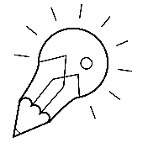
TIPS FOR SUCCESSFUL COLLABORATIONS​
Stay open to ideas you didn't expect. ​
Plan for emergent ideas and be willing to change direction.​
Honesty is key ingredient of any collaboration; make sure each player knows and is clear about what they expect from the partnership from the outset. There needs to be clarity on why the collaboration is taking place and what each partner hopes to achieve.​
Collaborations will repay you handsomely, as long as you are just as interested in the process as much as the outcome itself.
https://www.theguardian.com/media-network/media-network-blog/2012/feb/16/media-creative-collaborations-better-results ​

Slide 35
Challenge one another​
A creative collaboration is best when it challenges everyone involved. Be there to push. To spur. To spark new ideas. And to help the best ideas to be bigger.​
Encourage one another​
Ask for progress reports​
Be accountable​
Don’t think too small​
Never let great ideas be squandered
Adapted from:​
https://medium.com/@jasonkeath/partners-in-crime-the-power-of-finding-your-creative-collaborator-7d8aaf7af07b ​

Slide 36
Plan for Friction
Two people will often disagree on the best solution to a problem. But disagreements are opportunities for insight and can lead you to learn a new perspective on the problem. Some things to consider:​
Pick Your Battles: Decide which battles to fight. Weigh the cost and benefits of each debate and whether it is worth the friction. Don’t be afraid to defend a great idea with passion, but avoid creating unnecessary arguments.​
Listen For Passion: Be cognizant of the other person’s passion when disagreement takes place. If they are defending their ideas, it might be an opportunity for you to listen more.
Adapted from:​
https://medium.com/@jasonkeath/partners-in-crime-the-power-of-finding-your-creative-collaborator-7d8aaf7af07b ​

Slide 37
5 COLLABORATION TOOLS AT A GLANCE​
TEDx Events - great for networking and meeting possible collaborators​
Social Media e.g. Facebook Groups - use open groups to create an instant Creative ​Community or why not have a private group for your Creative Collective​
Enterpreneurship forums, expat forums, women's forums - great way for making international connections​
Meet up (website/app) - great way of making connections and finding creative networking events/groups near you​
Free online social collaboration platforms - e.g. Diigo and Pinterest ​
​

Slide 38

NETWORKING
As a female migrant entrepreneur, you may sometimes feel alone, without any resources to utilise but your own. Finding your network or tribe means having a ready-made group to provide support and encouragement. ​

Slide 39
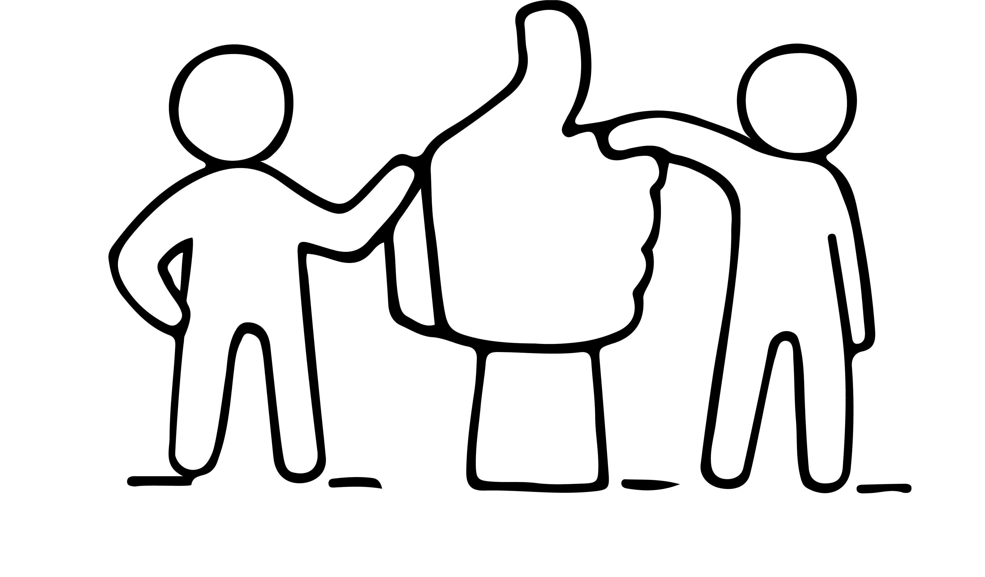
WHAT IS NETWORKING?
The Oxford Dictionary defines the verb “to network” as to ‘interact with others to exchange information and develop professional or social contacts’
Networking is a very deliberate and conscious act. It does not happen by accident and it is a two-way process.
Of relevance to our EMIMENT learners, analyses show that, in most cultures, women network in a different way from men. Women usually have smaller networks and closer relationships with their contacts than men.

Slide 40
WHAT IS NETWORKING?
Networking will be very useful at the start of your business when you are less well connected.
Networking keeps you in touch with opportunities. You can turn to more people for help and advice.
Effective networkers are more likely to
be offered opportunities.
Networking allows you to contribute something to others and build your reputation – people buy people.

Slide 41
TYPES OF NETWORKING
Networking is an effective low-cost method of increasing those who can support you to grow your business through referrals and introductions to develop sales opportunities and contacts.
Types of business networking
Strong Contact Networks (typically paid for networks that focus on referral business in the network , e.g. BNI: Business Network International | Business Networking
Casual contact networks - your attendance is optional – e.g. Chamber of Commerce networking events in your area
Online networks -
Community service – e.g. TERN – The Entrepreneurial Refugee Network – Supporting refugees into business (wearetern.org)
Professional Associations

Slide 42
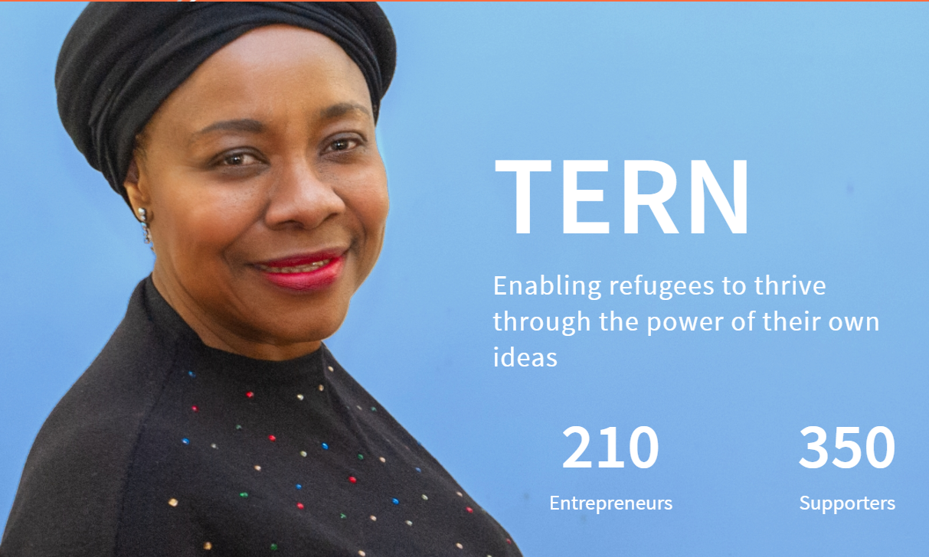
SPOTLIGHT ON TERN – The Entrepreneurial Refugee Network – Supporting refugees into business, UK
  www.wearetern.org
​
TERN enables refugees to thrive through the power of their own ideas. Their goal is to launch 2000 refugee-led businesses by 2025.
It has helped many female led businesses through Wearetern | Herfutureforward – full of wonderful examples of empowered refugee business women
TERNS include
Luxury handmade lingerie | Maria Callisto- Luxury Lingerie

Slide 43
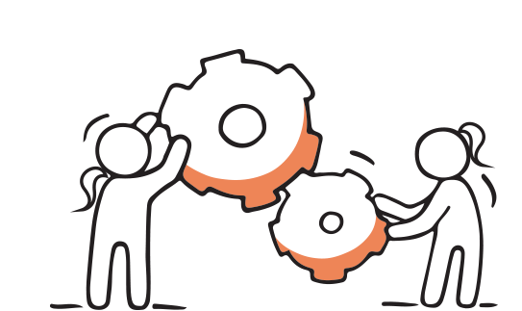
EXERCISE
  Research the networking platforms that you can access in your
  Area/region
  Sector
  Online specific that are relevant to your business
  How much time can you set aside to network each month?
​

Slide 44


WATCH
10 Simple Ways To Improve Your Networking Skills - How To Network With People Even If You're Shy!
3 networking tips for introverts
https://youtu.be/E5xTbn6OnAA
https://youtu.be/7eRyPdlEJ4Y

Slide 45
FOR DEEPER LEARNING,
THE DIFFERENCE IN FEMALE NETWORKING
READ Why Women Need To Network Differently Than Men To Get Ahead (forbes.com)
Women are more focused on building long-term personal connections or friendships.
Women often make contacts through people they know and tend to form smaller, deeper networks based on trust.
They also frequently seek advice for both personal and professional needs.
In contrast to men, women generally hesitate to ask for what they want out of a networking interaction. Instead, they think about what they can do for the other person first.
Many women don’t want to attend events after work, because they want to get home to be with their families (the majority of women are still the primary caregivers).

Slide 46
FOR DEEPER LEARNING,
THE DIFFERENCE IN FEMALE NETWORKING
READ How Women Network Differently Than Men - Small Business BC
Men generally go into networking opportunities with more clarity of what they want to achieve and with focus solely on their professional needs.
Women Connect on Multiple Levels: While many of the women are interested in learning more about business and how to improve their own, they also want to share the personal challenges they face in running both a business and maintaining family at the same time. A large component in networking is the process of women creating connections with each other.
In a women’s networking group, women feel safe to express how they FEEL about their work/life challenges and look to other women with similar experiences for support and advice.

Slide 47
FOR DEEPER LEARNING,
THE DIFFERENCE IN FEMALE NETWORKING
READ How Women Network Differently Than Men - Small Business BC
Women are Wired to Connect
Women are wired to connect and can be natural networkers. Typically women want to see other women succeed. While they do acknowledge competitors, they prefer to build capacity over competition. In some cases women try to work with their competitors, finding ways in which the two businesses can align to mutual benefit.
The Queen Bee is Not a Networker
Women are generally still fighting to define their place in the world of business. By connecting and networking with peers they are validating their important role and also beating the loneliness that can come from being a woman in business.

Slide 48
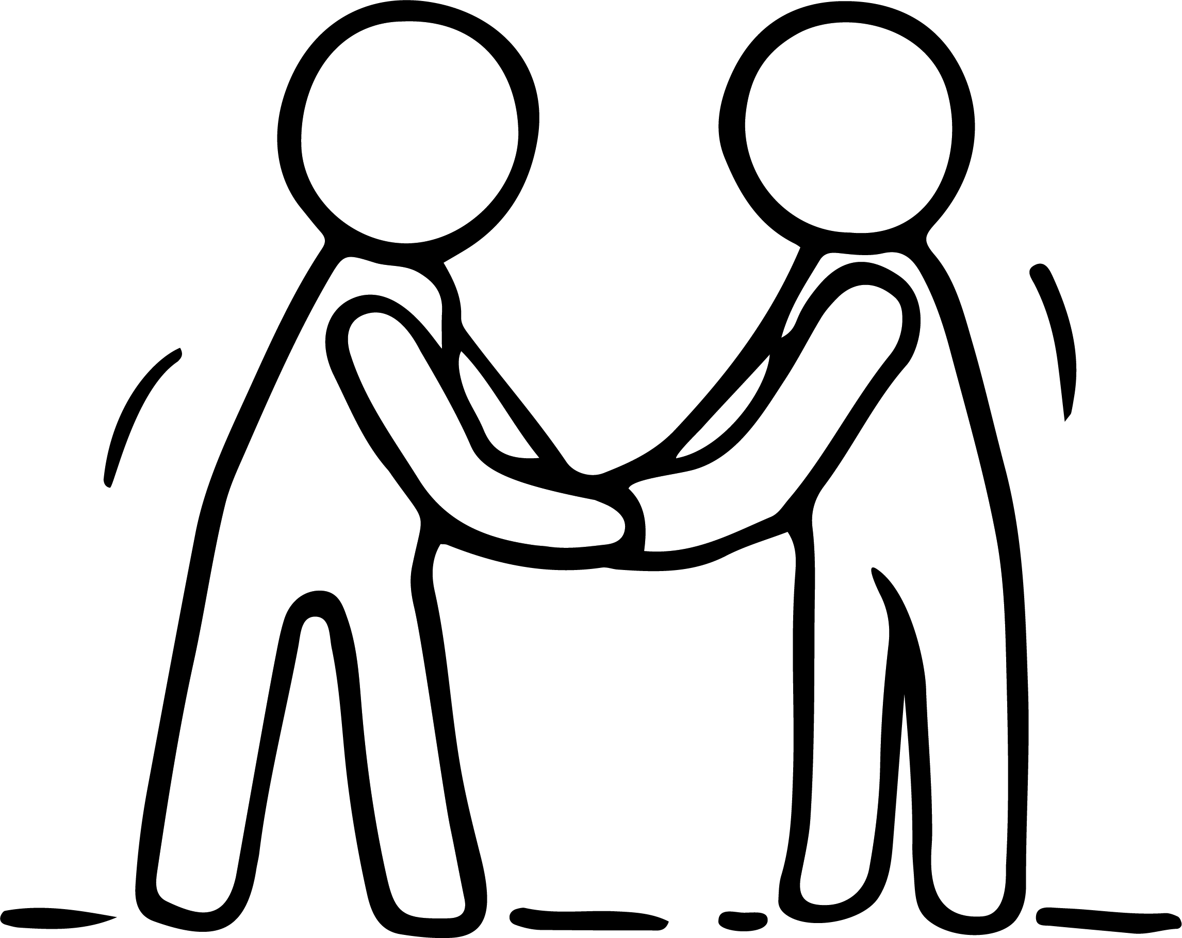
Overcoming barriers to networking
Networking sometimes has negative connotations reflecting suspicion about the motives behind it.
You may have heard people make comments such as ‘the old boys’ network’ which is an obvious challenge to female migrant entrepreneurs, but new types of networks and new ways of networking have emerged that mean that the accessibility of networking is increasing all the time.

Slide 49

RELEVANT EUROPEAN NETWORKS FOR
FEMALE ENTREPRENEURS

Slide 50
RELEVANT EUROPEAN NETWORKS FOR
FEMALE ENTREPRENEURS
  The European network to promote women’s entrepreneurship (WES) - The WES is a policy network with members from 31 European nations (the EU countries, Iceland, Norway, and Turkey). The delegates represent national governments and institutions. They are responsible for promoting and supporting female entrepreneurship at national level. WES members provide advice, support, information, and contacts regarding existing support measures for female entrepreneurs. They also help identify good practices.​
​

Slide 51
RELEVANT EUROPEAN NETWORKS FOR
FEMALE ENTREPRENEURS
  The European online Platform for women entrepreneurs (WEgate) - An online gateway to useful and inspiring information, mostly presented through a short description
  text and useful web links.
​ https://wegate.eu/
​

Slide 52

Next and finally Step 6
THE CONFIDENCE TO KEEP GOING AND KEEP GROWING
Resilience, Managing Risk and Managing Wellbeing
Enjoyed learning about Step 5?
Join in the conversation with your peers on our EMINENT Closed Facebook Group
A safe place to talk about your opportunities and challenges, excitement and fears.

