Slide 1
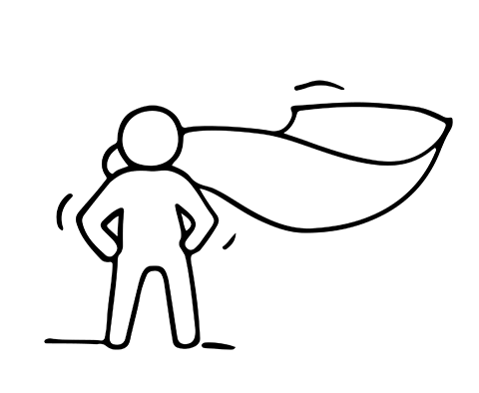
STEP 6
THE CONFIDENCE TO KEEP GOING AND GROWING
Resilience, Managing Risk and Managing Wellbeing
This programme has been funded with support from the European Commission
This project has been funded with support from the European Commission. This publication [communication] reflects the views only of the author, and the Commission cannot be held responsible for any use, which may be made of the information contained therein.

Slide 2
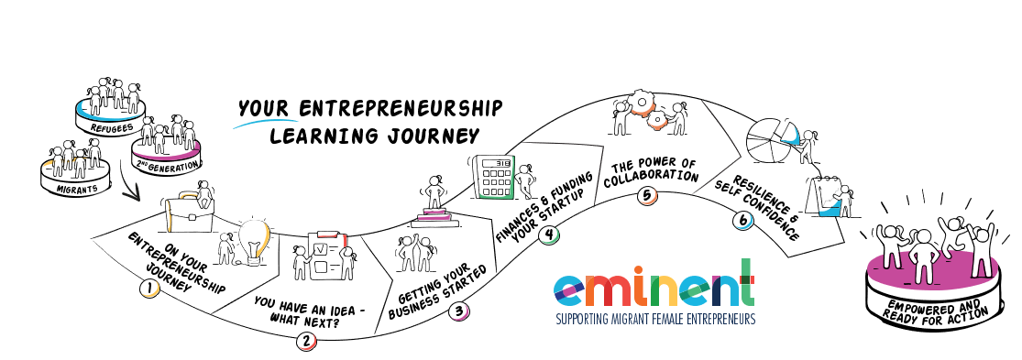
EMIMENT wants to enable Female Migrant Entrepreneurs. We want to bring you on your learning journey to gain the knowledge and skills you need to gain the confidence to establish and successfully run your own business.
Can you? Of course, you can. Open your mind and let us bring you on Your Entrepreneurial Learning Journey…….

Slide 3
IN STEP SIX, YOU WILL LEARN
PAGES
Entrepreneurship isn’t a job, it’s a lifestyle 4- 7
8 ways to boost your confidence in business 8 - 13
Taking risks 14 - 19
Building resilience - 7 useful tips and techniques to overcome stress 20 – 30
Defining Success 31- 41
Learn to live with failure 42- 49
Find happiness in your work and business 50 - 58
This is your final step on our EMIMENT entrepreneurship journey, we end, not by sharing more business advice, we end by sharing the essential tools to stay resilient and realistic. Your plan is never finished. In order to stay in business, you need strength and vision for the rewarding road ahead.

Slide 4
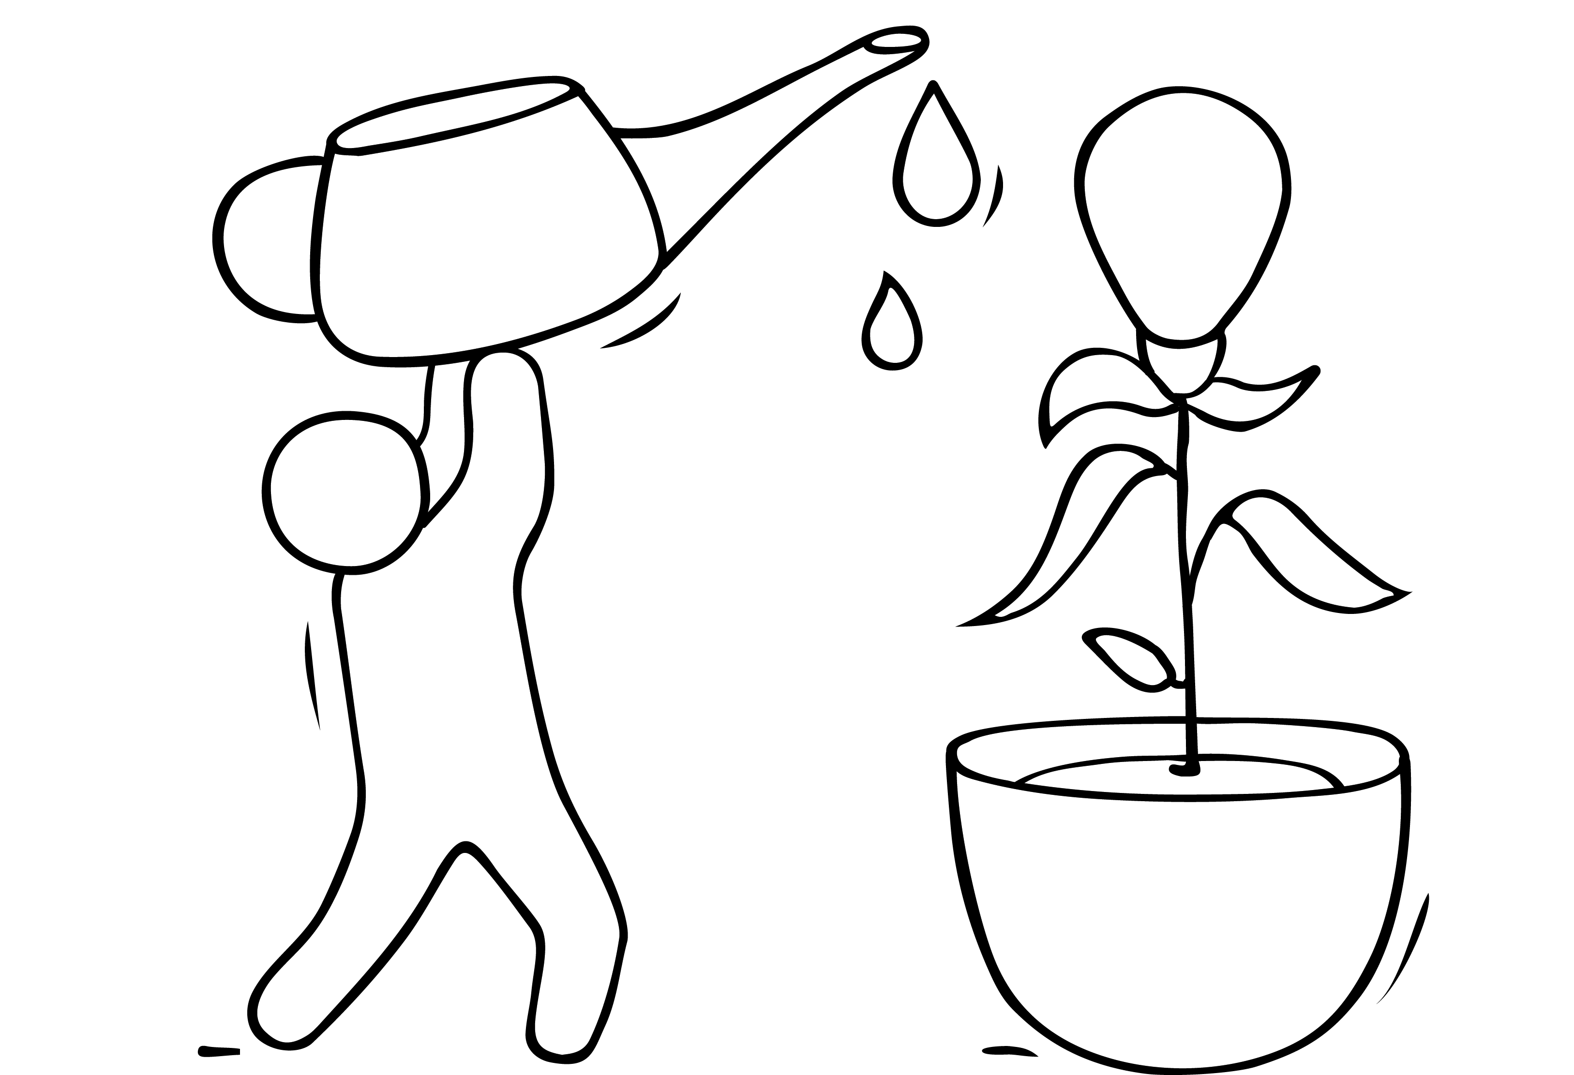
ENTREPRENEURSHIP ISN‘T A JOB – IT‘S A LIFESTYLE

Slide 5
ENTREPRENEURSHIP ISN‘T A JOB – IT‘S A LIFESTYLE
While new entrepreneurs generally find their mission fulfilling, over time, disillusionment can creep in.
The rigors and challenges of entrepreneurship can wear on you over time, compromising your relationships and getting in the way of your happiness. When you mix in the pressures of Covid-19, it is a greater challenge. The UN found clear evidence that, although both genders have seen their unpaid workloads increase, women are bearing more of the burden than men.
They is why we are dedicating a full step to resilience and ensuring that your wellbeing as a migrant woman entrepreneur is recognised as vital part of the business approach.
READ: Whose-time-to-care-brief_0.pdf (unwomen.org)

Slide 6
ENTREPRENEURSHIP ISN‘T A JOB – IT‘S A LIFESTYLE
When you first delve into entrepreneurship, despite all your business planning, it’s likely you’ll have no idea what you’re doing.
You’ll mess up, you’ll become disheartened when your plans don’t work out, and you’ll become tired after pouring all your effort (and cash) into an idea that may or may not pay off.
However, pushing through the experience, whether it ends in success or failure, will change your perspective for the better and give you experience that you can use in your next venture.

Slide 7
ENTREPRENEURSHIP ISN‘T A JOB – IT‘S A LIFESTYLE
READ – this really interesting article from Wordsqueen Anshika Vyas who started her own entrepreneurial enture as a co-founder in 2018. Due to lack of investment, she had to face financial issues that let her learn through her mistakes and what measures to take before starting a business.
Why Entrepreneurship is a Lifestyle, not a Job - (wordsqueen.com)

Slide 8
8 WAYS TO BOOST YOUR CONFIDENCE IN BUSINESS
1. Get clear on your higher purpose
When you attach yourself to a higher purpose, promoting yourself and your work becomes much less about you and what people think of you and much more about how many people you are helping.
2. Stop waiting to feel confident
One of the biggest tricks that the mind plays on us when it comes to moving forward is the idea that we have to feel confident before we can move forward. This just keeps us very stuck. A huge turning point is when you realize that you can take action in spite of fear rather than waiting for it to go away and then acting confident even if you didn’t feel it.
READ Ryan James Lock is an international success coach and business consultant. 8 Ways To Boost Your Confidence In Business (wisdomtimes.com)

Slide 9
8 WAYS TO BOOST YOUR CONFIDENCE IN BUSINESS
3. Focus on the benefits to the customer
When promoting your business, products or services always focus on the benefits to the customer. People are surrounded by noise all day, if you can make it very clear how the customer benefits from working with you then you are already half way there.
Another benefit of focusing on the benefits to the customer is that it takes you out of the equation, your focus is on them and how you can help which makes them feel heard and understood and allows you to act with a higher level of confidence than before.
READ Ryan James Lock is an international success coach and business consultant. 8 Ways To Boost Your Confidence In Business (wisdomtimes.com)

Slide 10
8 WAYS TO BOOST YOUR CONFIDENCE IN BUSINESS
4. Understand you are not your work
You are much more than the work that you do, when you promote your business and the services you offer – it is not about you personally and it’s very important to get clear on that. Women who are self employed often attach too much of their self image to their work and this can lead to additional pressure.
5. Learn to love NO
Afraid of people saying no to you ? Then you are going to find it really hard to succeed. Instead of fearing the word no, learn to love it! Think of it like this, every time someone says no to you it means you are one step closer to getting the big YES that you want. Try and learn from each no you get, how can you learn and grow? Develop an attitude of looking forward and constantly being open to learn.
READ Ryan James Lock is an international success coach and business consultant. 8 Ways To Boost Your Confidence In Business (wisdomtimes.com)

Slide 11
8 WAYS TO BOOST YOUR CONFIDENCE IN BUSINESS
6. Get over your fear of rejection
We all have a fear of rejection, it’s part of being a human – but it doesn’t have to keep you stuck or hold you back. Understand that it’s not about you, it’s just business and that you are far bigger than any perceived rejection.
7. Play “How would I act….”
A great exercise is “How would I act if…”. Write down on a piece of paper how you would act if they felt confident, ready, able, powerful etc. Describe how you would speak, act, talk, dress and “show up” in the world. Then act it out, starting your day as if they already have what you want.
READ Ryan James Lock is an international success coach and business consultant. 8 Ways To Boost Your Confidence In Business (wisdomtimes.com)

Slide 12
8 WAYS TO BOOST YOUR CONFIDENCE IN BUSINESS
8. Practice
Confidence is just like a muscle, it gets stronger the more you use it. Instead of only using your confidence when a need arises, practice being the confident version of yourself through out your day.
Ask yourself questions like “How can I practice my confidence now?” It could be as simple as accepting an invitation to a networking event, reaching out to someone over e-mail or even following up with a prospect, the more you practice the easier it becomes.
READ Ryan James Lock is an international success coach and business consultant. 8 Ways To Boost Your Confidence In Business (wisdomtimes.com)

Slide 13
CONFIDENCE, A KEY INGREDIENT
WATCH
Confidence is just as, if not more, important in life than competence. Being an entrepreneur takes an incredible amount of confidence for things you probably would never expect. In this video, Erin discusses 5 unexpected situations you need confidence for in entrepreneurship, and share a recent personal experience that truly put her confidence to the test.
Challenges I Face Being a Young, Black, Woman Business-Owner
https://youtu.be/JDSisEGISwg

Slide 14
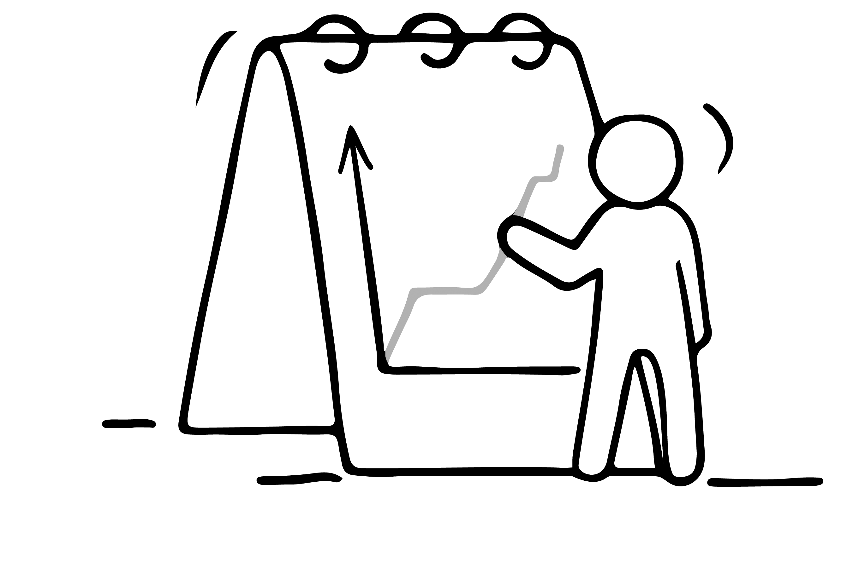
TAKING RISKS

Slide 15
TAKING RISKS VS. BEING RISKY
It’s important to understand the difference between taking risks and being risky.
Taking risks is a regular part of our lives. We take on certain risks daily in order to enjoy valuable rewards. Most of us have learned to solve this risk vs. reward equation quickly in our heads, and failure rates are low.
Being risky, on the other hand, is a behaviour trait which is characterised by doing careless actions. It involves much higher failure rates and more serious consequences.
Source: https://www.forbes.com/sites/brockblake/2019/04/23/3-steps-to-take-more-calculated-risks-as-an-entrepreneur/

Slide 16
CALCULATING RISKS IN 3 STEPS
As an woman entrepreneur, you will often be faced with difficult decisions. To help you in these situations, here is an effective three-step process for calculating risk vs. reward.
Remove the fear of failure
We often let fear of failure hold us back. It is the number one reason why most people avoid risk, and therefore never end up making the necessary decisions.
You need to examine the cost of not taking a risk. Can you afford it?
Source: https://www.forbes.com/sites/brockblake/2019/04/23/3-steps-to-take-more-calculated-risks-as-an-entrepreneur/

Slide 17
CALCULATING RISKS IN 3 STEPS
Do your sums
When weighing on risk vs. reward, you need to do the sums, literally.
Look at all the ways you can fail and what it will cost you. Then, consider how you can push the boundaries just enough to make some mistakes and learn quickly. From there, adjust your way and go.
Along the way, some decisions will be wrong, but you’ll get comfortable with that. Be open to adjusting to get back on track.
Let others challenge you
For entrepreneurs, the higher the risk, the more homework there is to do. You can ask others in your network to create a list of the reasons why something won’t work. This will help you define the risks more clearly.
Source: https://www.forbes.com/sites/brockblake/2019/04/23/3-steps-to-take-more-calculated-risks-as-an-entrepreneur/

Slide 18
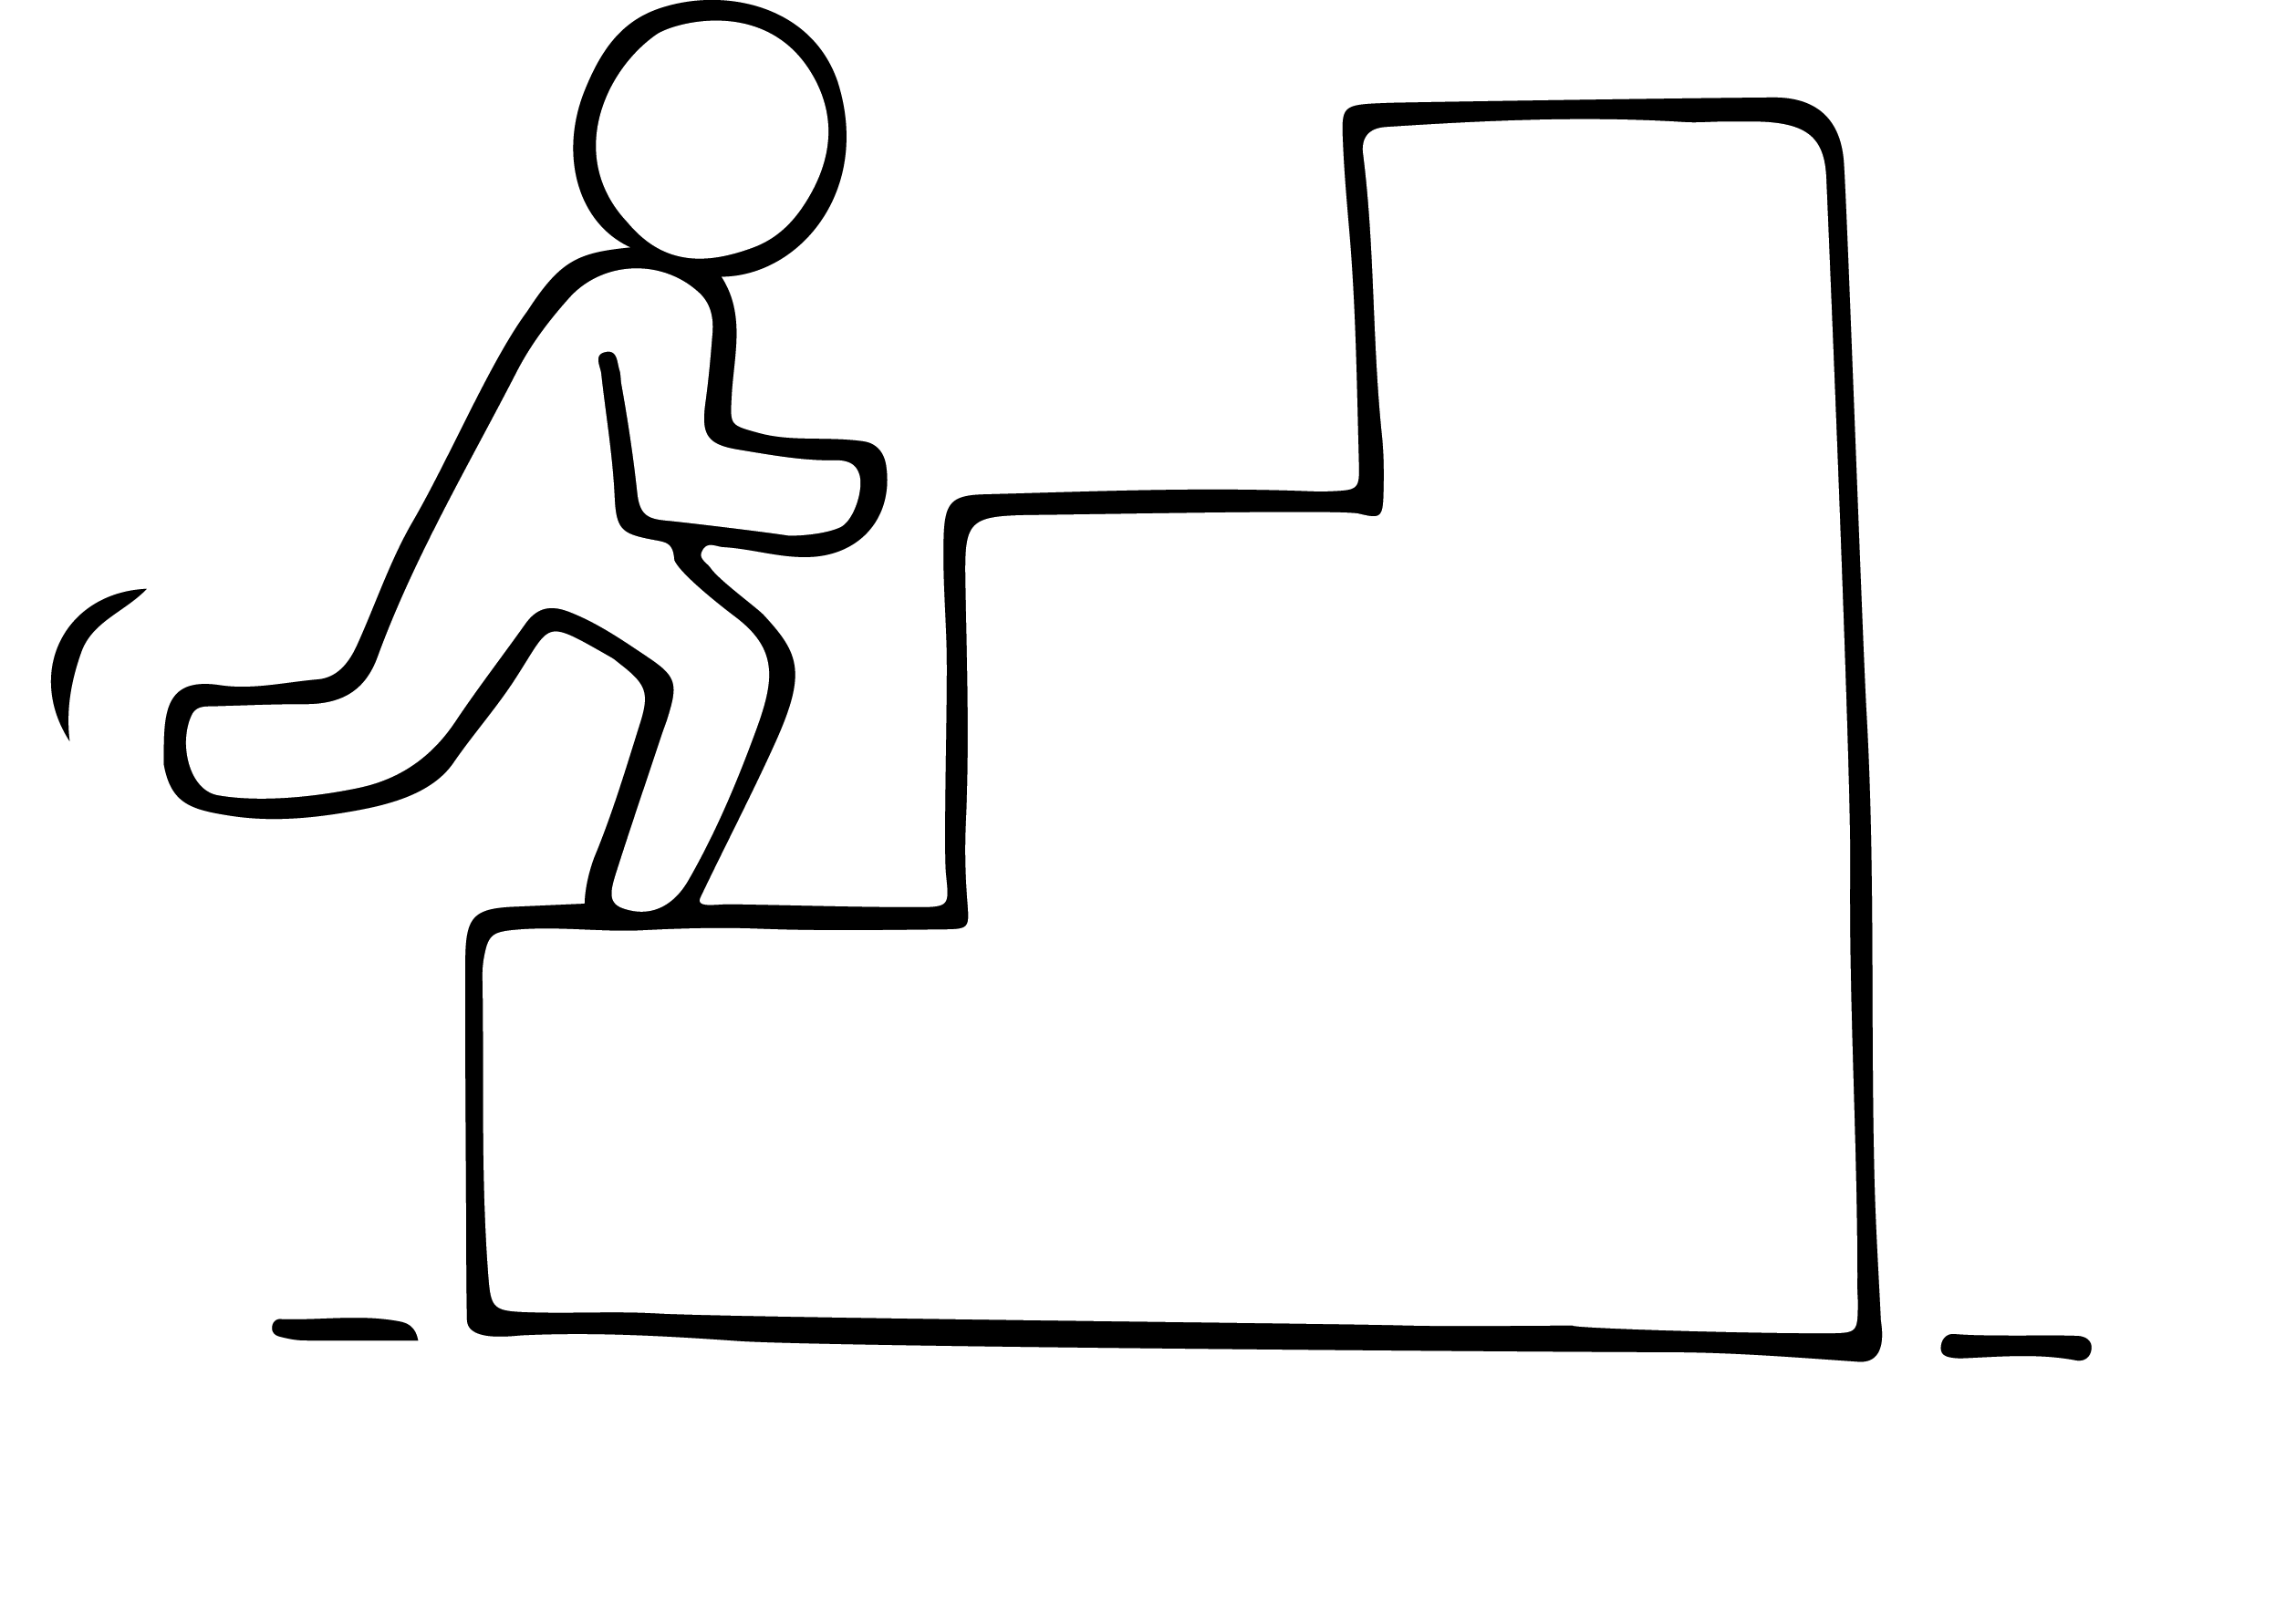
HOW RISK-TAKING BOOSTED THE CAREERS OF SUCCESSFUL ENTREPRENEURS
The entrepreneurs behind some of the world's most successful corporations have one thing in common: They've all embraced risk-taking.
They are living proof that success is neither about being risk-averse nor about taking uncalculated risks. Success lies somewhere between the two.
Source: https://www.inc.com/partners-in-leadership/5-wildly-successful-entrepreneurs-reveal-how-risk-taking-propelled-their-careers.html

Slide 19
HOW RISK-TAKING BOOSTED THE CAREERS OF SUCCESSFUL ENTREPRENEURS
1. Oprah Winfrey
"Do the one thing you think you cannot do. Fail at it. Try again. Do better the second time. The only people who never tumble are those who never mount the high wire."
Source: https://www.inc.com/partners-in-leadership/5-wildly-successful-entrepreneurs-reveal-how-risk-taking-propelled-their-careers.html
Image source: https://www.prnewswire.com/news-releases/oprah-winfrey-and-weight-watchers-join-forces-in-groundbreaking-partnership-300161712.html

Slide 20
BUILDING RESILIENCE

Slide 21
OVERCOMING STRESS
Entrepreneurship can be a minefield of factors that may have a negative impact on your mental wellbeing.
Stress, anxiety, insomnia are only some of the issues that can emerge from feeling overwhelmed in your business. This can stem from an unrealistic workload, financial pressures or difficulties with customers or staff.
There are 7 useful tips and techniques which you can learn to help you through the stress…

Slide 22
1. GET BETTER AT DEALING WITH CHANGE
Bouncing back from disappointment & difficulty means using the response flexibility in our brains to shift our perspectives, see options that we couldn’t see before..
By shifting our response, we become more resilient; we learn and grow; we recover our well-being.
We strengthen our capacity to challenge life events, even potential crises, by mindfully, compassionately paying attention to our reactivity.
“How you respond to the issue…is the issue.“
—Frankie Perez

Slide 23
2. AVOID ENTREPRENEURSHIP BURNOUT
Entrepreneurship demands sacrifice and commitment, and even if you go into it with a sparkling optimistic attitude and a great support system, the daily rigors and stresses of business ownership will begin to take their toll on you.
Burnout is unfortunately common among women entrepreneurs. After months or years of constant effort, it’s only natural that you’d start feeling exhausted or frustrated in your business.

Slide 24
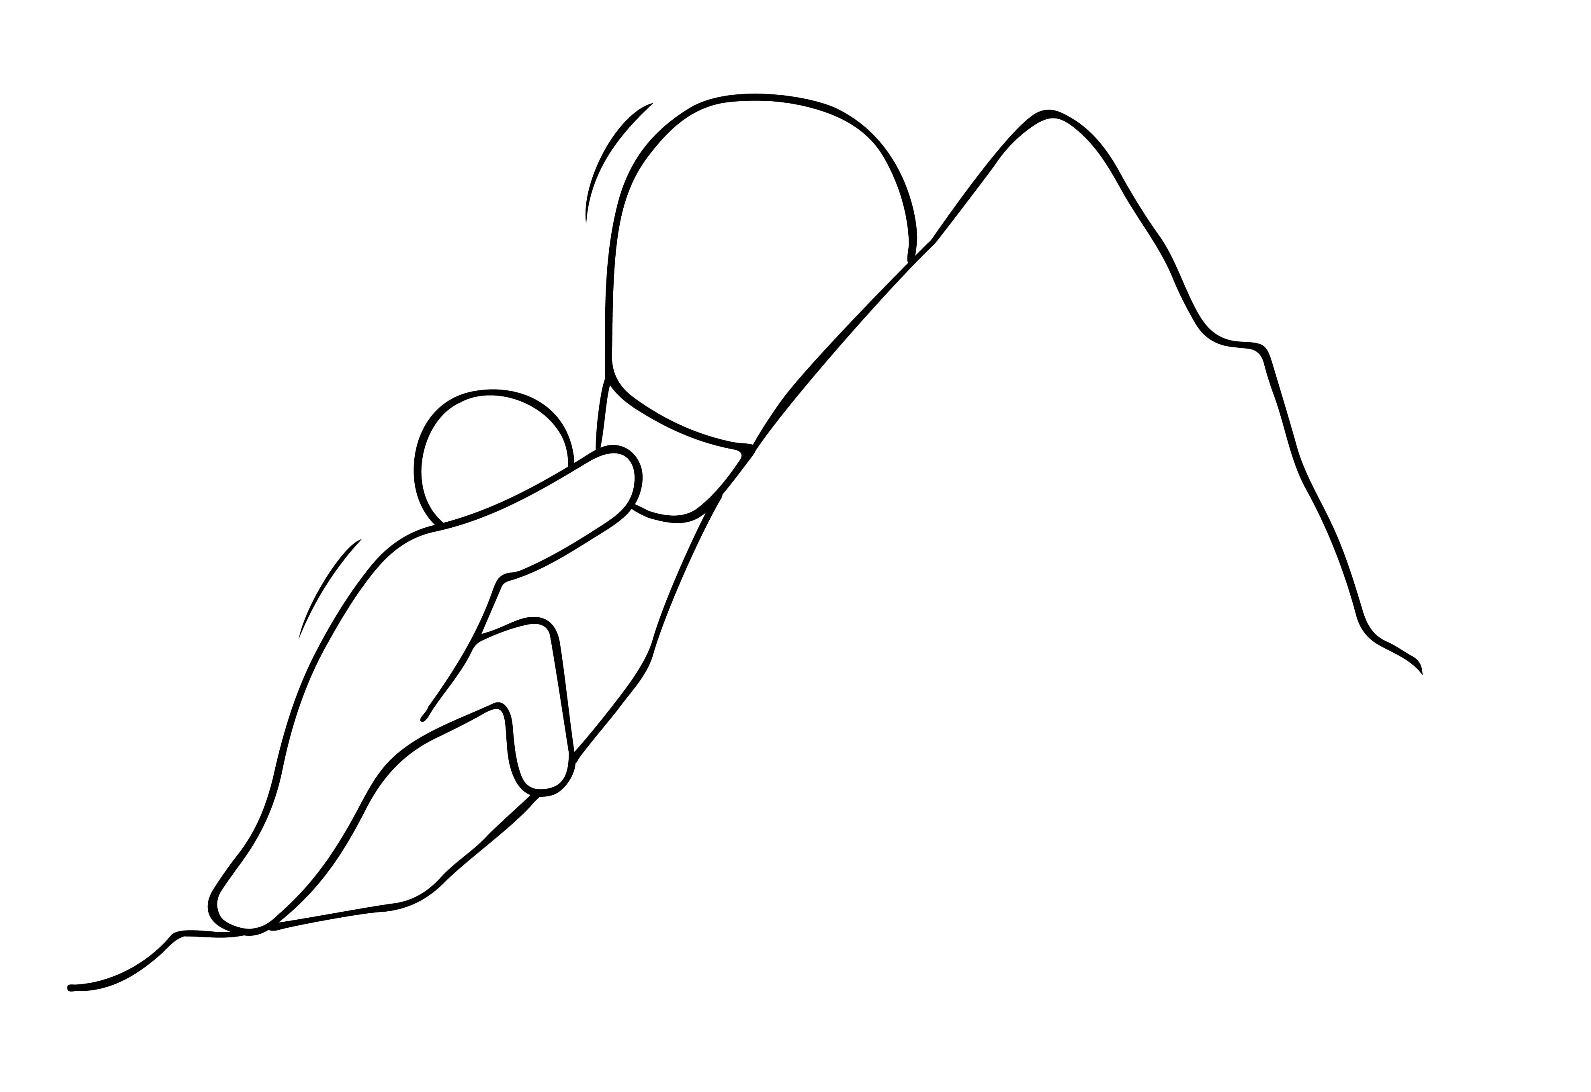
2. AVOID ENTREPRENEURSHIP BURNOUT
To avoid or mitigate that burnout, and remain interested in your work, try these long-term strategies:
Set realistic expectations
Establish boundaries
Change up your routine
Remind yourself why you got started
Take real time off

Slide 25
3. THINK HEALTHY, WORK HEALTHY
SET REALISTIC EXPECTATIONS.
Burnout is a product of fatigue and/or disappointment. Fatigue tends to happen when working for too long without satisfactory results, and disappointment tends to happen when reality falls short of your hopes. Both are products of setting unrealistic expectations for yourself. For example, if you tell yourself your product must launch by the end of the month (when three months is more reasonable), you could burn yourself out rushing to get things done or disappoint your clientele.
Set more manageable expectations for yourself and your business, in terms of your goals, your hopes, your daily tasks, and everything in between.

Slide 26
3. THINK HEALTHY, WORK HEALTHY
ESTABLISH BOUNDARIES.
Being a woman entrepreneur is a lifestyle choice as much as it is a professional one. For most women entrepreneurs, your professional responsibilities will fall into your personal life, and your personal life into your business time. Especially in the early days. To avoid burnout over the long term that you set real boundaries for yourself. How about:
Not taking any work-related calls or answering emails after 7pm on weekdays
Not taking work calls during family time
Only doing work for a set number of hours during the weekend

Slide 27
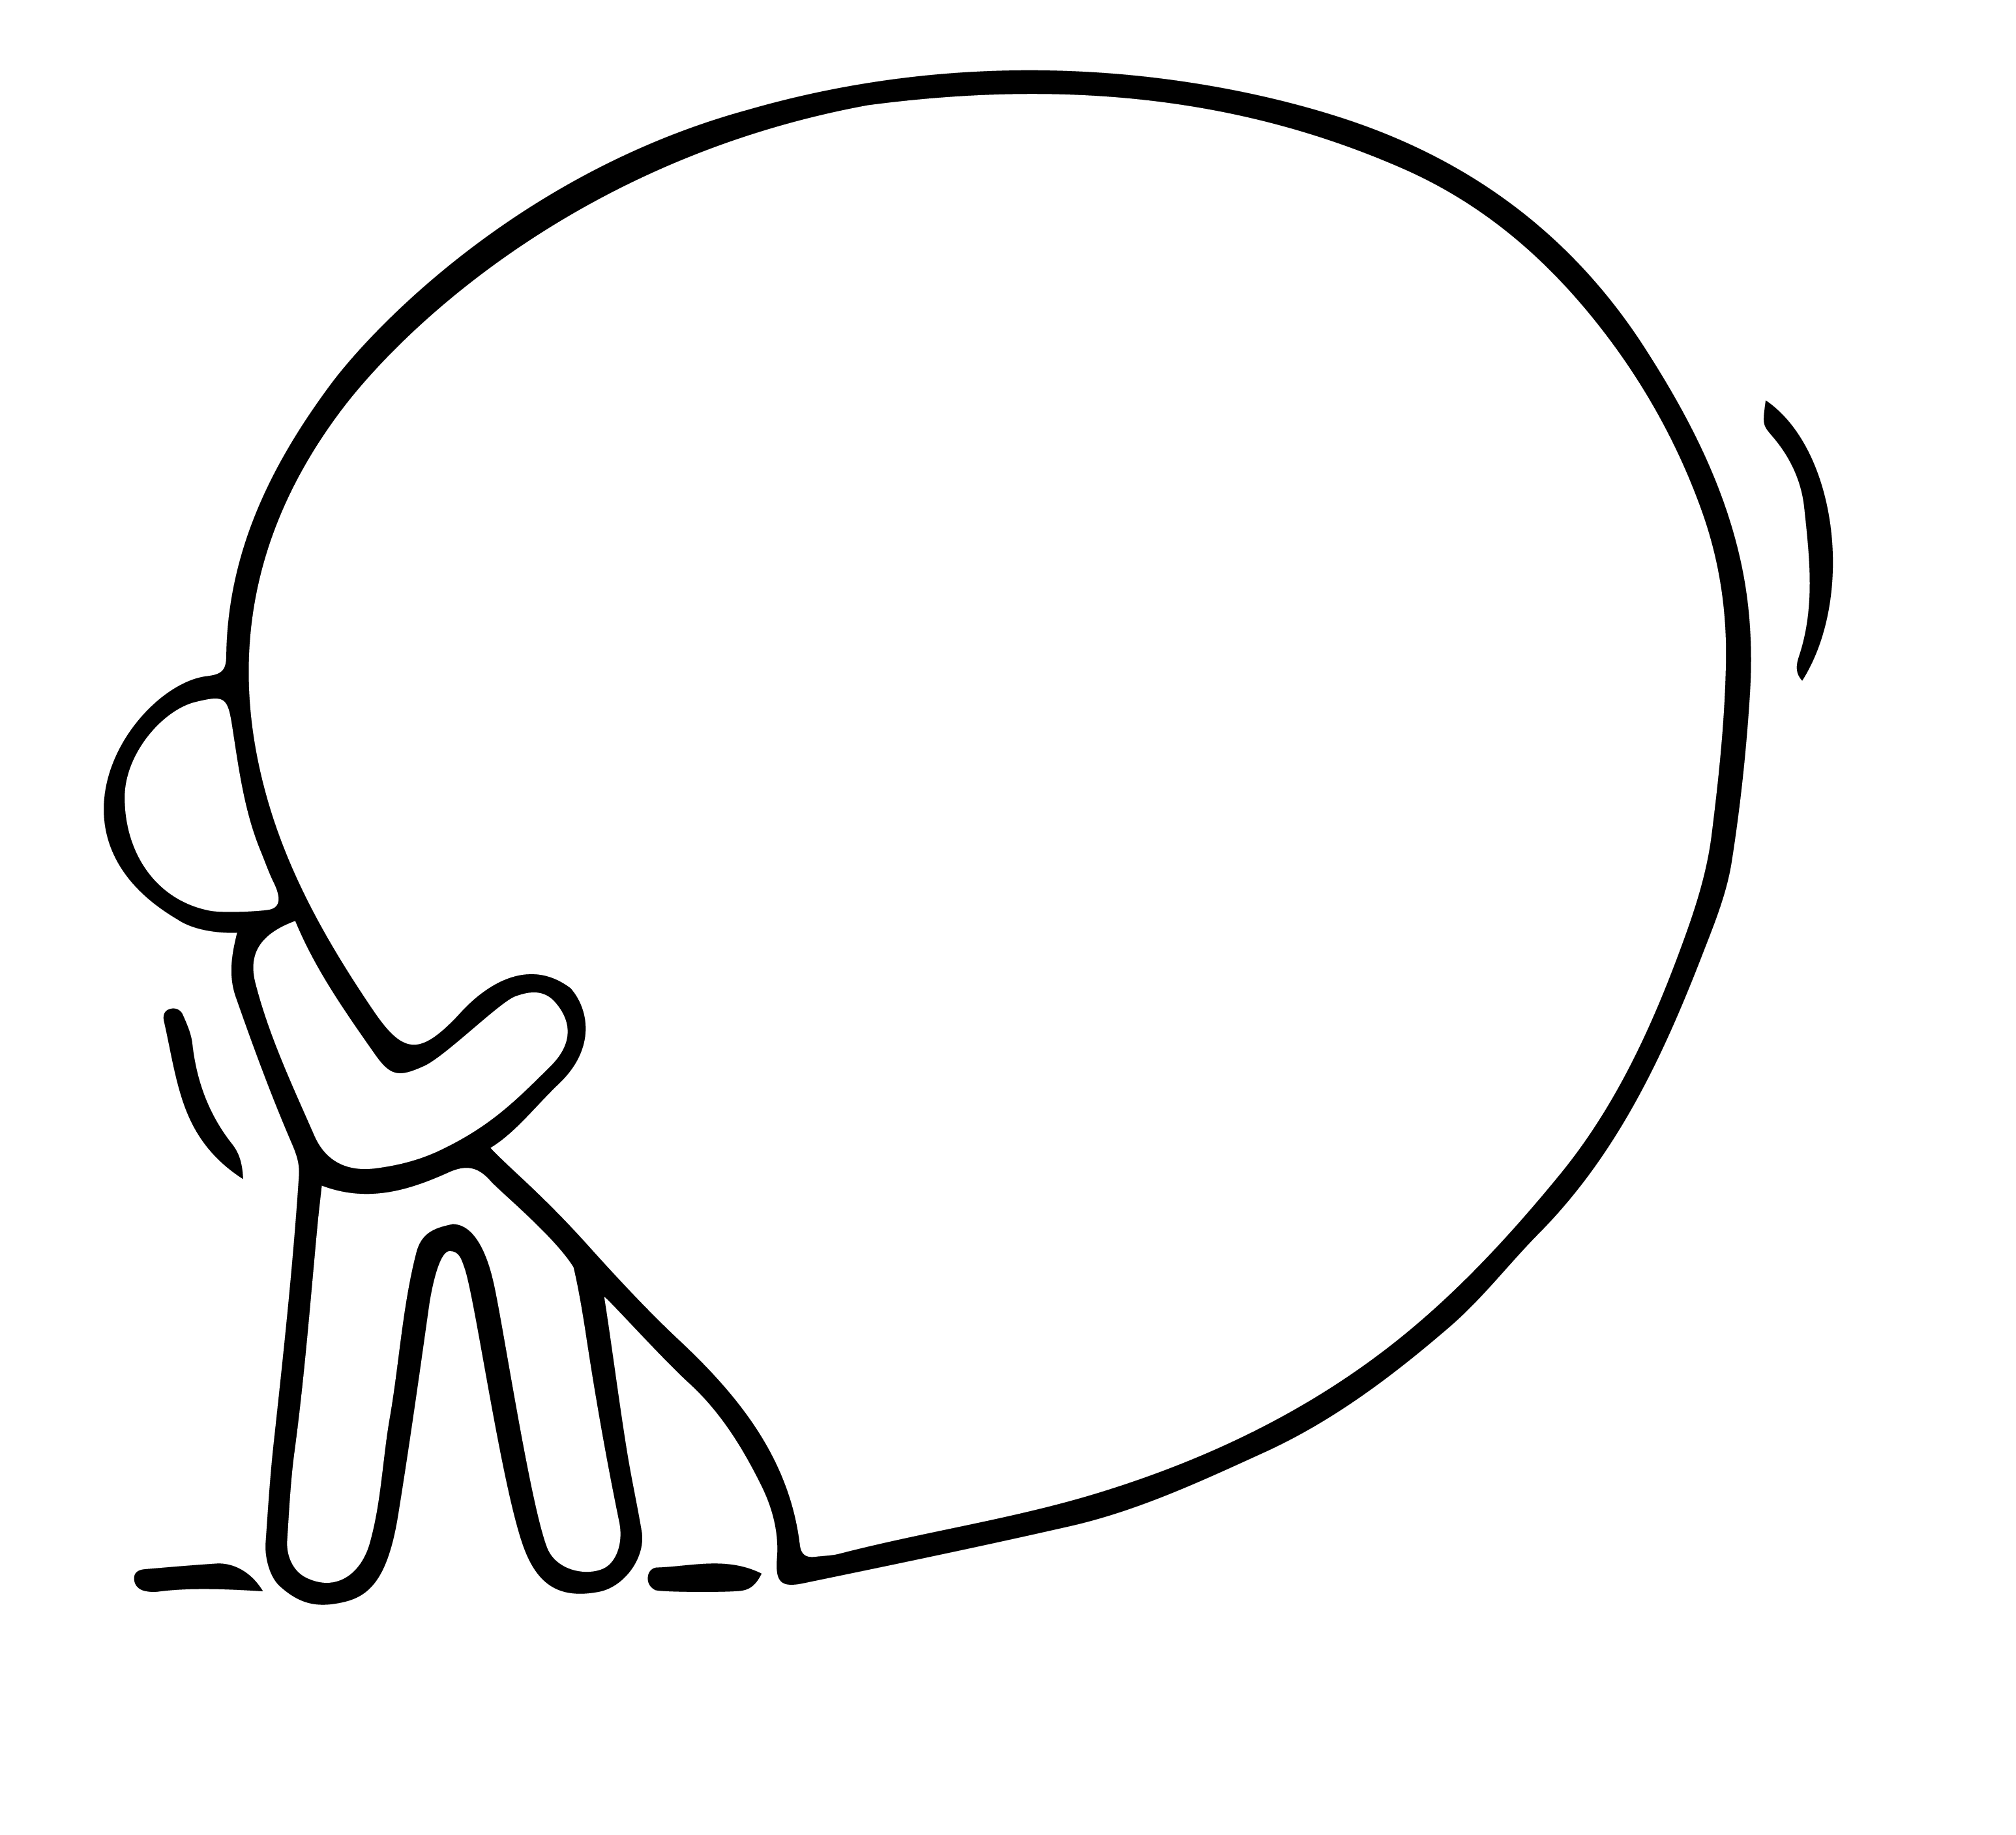
“NO“
4. DON‘T BE AFRAID TO SAY “NO“
While it's always nice to be the hero and adhere to everyone's wants and desires, doing this can take up an unreasonable amount of time.
This is one of the key learnings shared by women entrepreneurs.
You must be willing to say no in situations that do not add as much value to your business as other opportunities.
When a client demands a near-impossible deadline, you may feel obliged to say yes in order to keep their all-too-important sale.
Think carefully about each situation, and don’t be afraid to say no if it doesn’t make sense to say yes.

Slide 28
5. REMIND YOURSELF WHY YOU STARTED
Most women choose to be entrepreneurs at least in part because they seek more fulfilling work. Whatever the case, women entrepreneurs generally go into business with the expectation that entrepreneurship is going to make them happier and improve their lives.
Remind yourself regularly what was that great goal and the reasons you are determined to set up a business and make it a success.

Slide 29
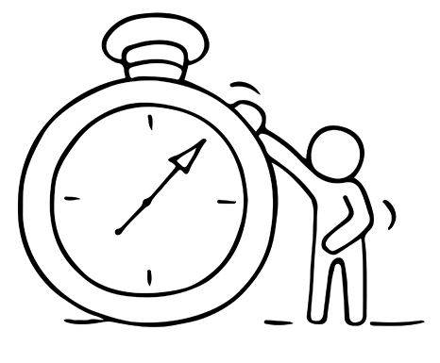
6. TAKE REAL TIME OFF
Research shows you get more done quicker when you step back and recharge the brain and body.
Studies show that performance increases after breaks of all durations: from a short holidays down to microbreaks of 30 seconds.

Slide 30
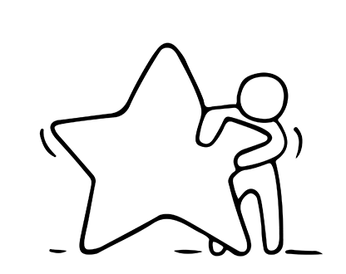
7. CREATE YOUR IDEAL ENVIRONMENT
The spaces we occupy shape who we are and how we behave. This has serious consequences for our psychological well-being.
Given that many of us spend years working in the same room, or even at the same desk, it makes sense to organize and optimize that space in the most beneficial ways possible.
Creating your ideal environment means looking honestly at what's working and what isn't in your working environments.

Slide 31
DEFINING SUCCESS

Slide 32
SUCCESS – WHAT DOES IT LOOK LIKE?
We all see success differently. Our aspirations are influenced by our upbringing, our environment, our image of ourselves, and the people we live and work alongside. As migrant women, your background and the challenges you have overcome is part of your motivation to succeed.
Success is not just about having more money, it’s deeper than that. Success can be complex, but it can also be quite simple. You can have success and get the things you want with more ease, and enjoyment.
But first you have to have real insight into what is your personal and real motivation for success.

Slide 33
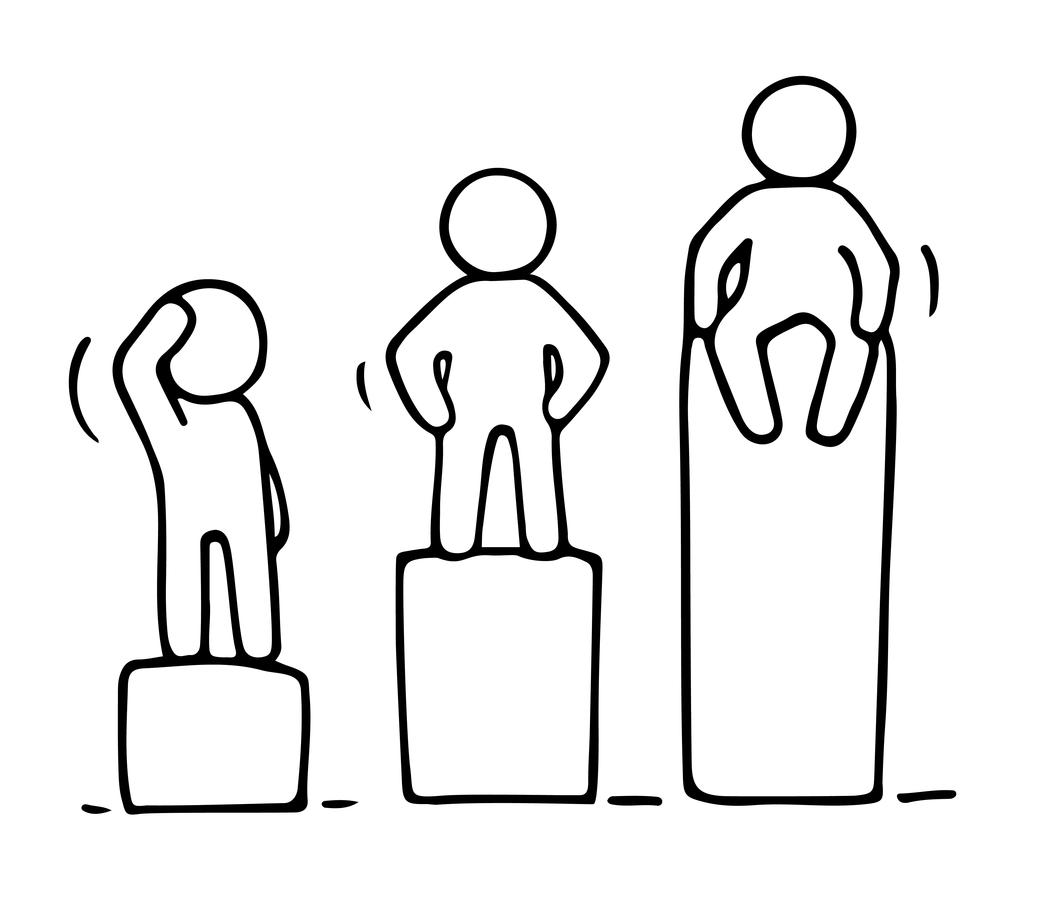
HOW IS SUCCESS DEFINED?
1. the attainment of fame, wealth, or social status
2. the accomplishment of an aim or purpose
3. a person or thing that achieves desired aims
A combination of the above? Or something else?

Slide 34
DID YOU KNOW – THERE ARE 10 TYPES OF SUCCESS?
MATERIAL SUCCESS – Money, cars, holidays, jewellery
EMOTIONAL SUCCESS – Relationships, self-esteem, contentment
INTELLECTUAL SUCCESS – Learning, understanding, challenging
SPIRITUAL SUCCESS – Sense of purpose, belonging, reason
PHYSICAL SUCCESS – Health, fitness, vitality, appearance

Slide 35
DID YOU KNOW – THERE ARE 10 TYPES OF SUCCESS ?
COMMERCIAL SUCCESS – Enterprise growth, profit, reputation
EVANGELICAL SUCCESS – Influencing others, promoting your ideals
ENVIRONMENTAL SUCCESS – Home, garden, saving the planet
TIME SUCCESS – Longevity, time management
COLLECTIVE SUCCESS – The product of effective teamwork

Slide 36
DEFINING SUCCESS ON YOUR OWN TERMS
Every experience that we go through presents an opportunity to learn about ourselves and the world around us.
By seeking to find the lessons learned in our past you will be able to articulate better what you want to achieve in your life moving forward, both personally and professionally.
Stop comparing yourself to others or wondering how your life “should” look. Realising that the definition of success is different for every single person out there is important.
Source: http://www.huffingtonpost.com/carissa-lada/what-does-success-look-like_b_5651592.html

Slide 37
LEARNING FROM LEAH HEWSON
Leah Hewson is an Irish artist. It took her a few careers and study detours before she finally accepted her creative career vocation & now her career is thriving.
What success means to her…
“I used to think you have to have an end goal and you have to have a huge dream. What works better for me is that I’m moving forward, even if it’s just a small bit. It means that I’m constantly drawing or making or thinking about it. It might not happen as quickly as you want it to, but it’s happening at that moment.”
READ http://themakersstories.com/2017/01/11/young-irish-artist-talks-failing-succeeding/

Slide 38
EXERCISE DEFINE SUCCESS ON YOUR OWN TERMS
RELFECTION AND VISUALISATION
Who do you want to be?
Stripped of all expectations, becoming your true self is your life’s purpose.
What is your passion? Your real passion, if there were no obstacles.
Dare to be different. Define and measure your successes differently.
Too much conformity leads to groupthink and failure.
To be a true entrepreneur, you need to think differently and not feel the pressure to conform.
Don’t feel the need to define your successes by other people‘s standards.

Slide 39
EXERCISE: SUCCESS – WHAT DOES IT LOOK LIKE?
While this is best completed as a Group Exercise, it can also be used as an individual reflection exercise. Materials Needed: a selection of random images to include people, buildings, objects, cars etc.
Choose 3 images that you feel represent success. Write down the main points that you think they represent success.
If this is a group exercise, each group shows their photos in turn and explains why they think it represents success.
Exercise findings: This exercise may lead you to challenge traditional views on success. It shows that success has many different meanings to different people. It will also introduce the idea of there being different types of success.

Slide 40
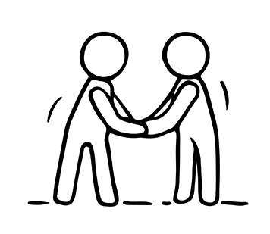
ACHIEVING NEW LEVELS OF SUCCESS
To achieve success, entrepreneurs must routinely re-focus their efforts by:
Developing a clear vision of where you want to go with realistic and actionable goals (Our goal setting exercises which follow will help)
Prioritising what’s important
Delegating – when you have the resources, this will liberate your key productive talents – the things that you do best
Be willing to learn new skills

Slide 41
SETTING REALISTIC AND ACHIEVABLE ENTREPRENEURIAL SMART GOALS
Goal setting is an important part of life, business and mentoring. There are some parameters to goal setting that everyone should know and follow. The easiest way to remember them is to think SMART.
Specific. Goals need to be very clear and as detailed as possible.
Measurable. Goals need to be tangible; results need to be measurable. Ask yourself questions like: “When?” and “How much?”
Action-oriented. Make sure you can identify the steps you need to take to reach each goal.
Source: http://www.futurpreneur.ca/en/resources/understanding-entrepreneurship/articles/setting-achievable-goals/

Slide 42
LEARN TO LIVE WITH FAILURE
Failure feels bad for everyone. Most people will go to great lengths to avoid it, so we don’t have to feel the painful emotions.
Knowing how to cope with failure takes some of the fear out of failing, and it might reduce the pain so you can rebound more easily than before.
We now show you 7 ways to live with failure

Slide 43
1. EMBRACE YOUR EMOTIONS
Researchers discovered that thinking about your emotions helps more than thinking about failure itself.
Allowing yourself to feel bad can be motivating. It can help you work harder to find better solutions so that you’ll improve next time.
In fact, many entrepreneurs consider that failure leads to success.
Source: https://www.verywellmind.com/healthy-ways-to-cope-with-failure-4163968
Nelson N, Malkoc S, Shiv B. Emotions Know Best: The Advantage of Emotional versus Cognitive Responses to Failure. J Behav Decis Mak. 2017;31(1):40-51. doi:10.1002/bdm.2042

Slide 44
2. PRACTICE HEALTHY COPING SKILLS
Recognize the unhealthy ways you try to avoid or minimize your pain. Turning to those coping skills that do more harm than good will only make your situation worse.
Some examples of healthy coping skills are to call a friend, practice deep breathing, go for a walk.
However, not every coping skill works for everyone, so it’s important to find coping skills that will work for you and turn to those when you’re feeling bad.
Source: https://www.verywellmind.com/healthy-ways-to-cope-with-failure-4163968

Slide 45
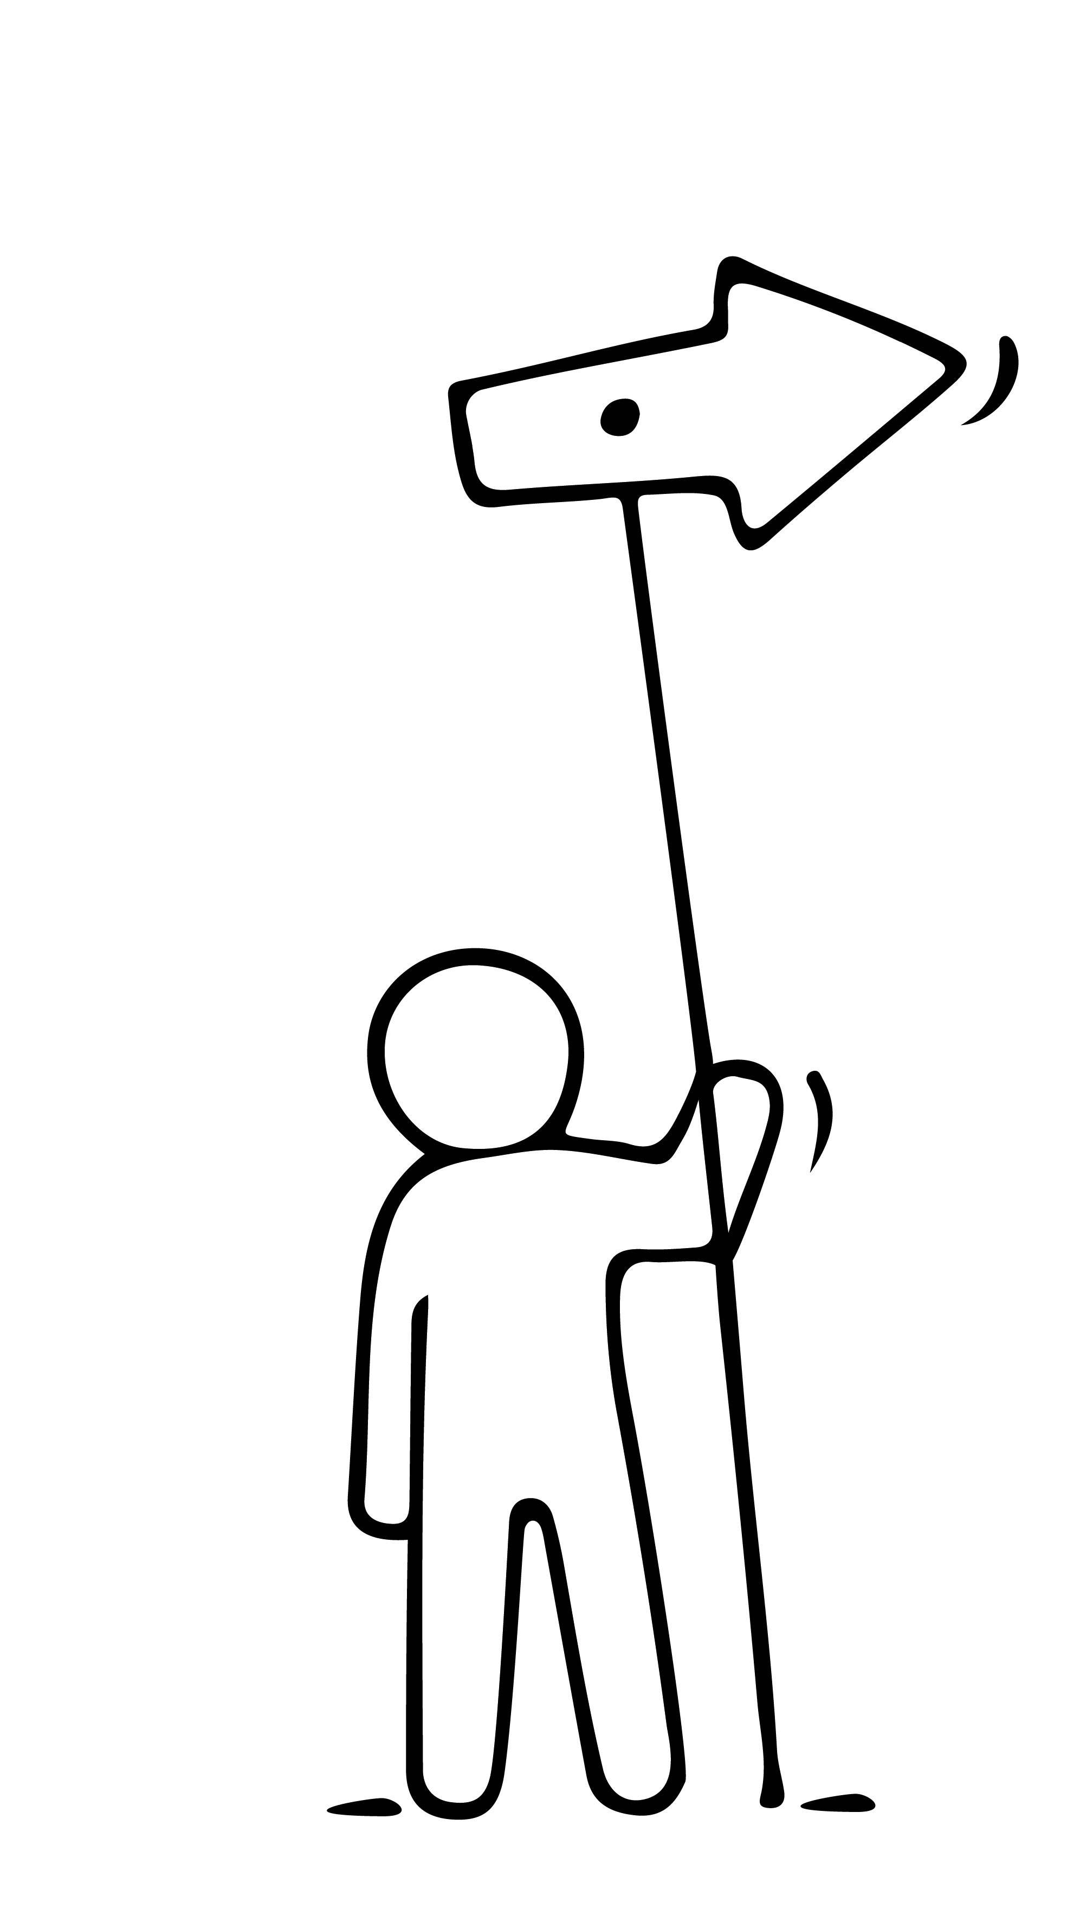
3. ACKNOWLEDGE IRRATIONAL BELIEFS ABOUT FAILURE
You may have developed some irrational beliefs about failure at some point in your life. Perhaps you think failure means you‘re bad or that you‘ll never succeed.
Some women who came to a new community/country with a different language from their native language start feeling bad when their new language skills are any less than perfect. But in reality, knowing any level of additional language is a great success, not a failure.

Slide 46
4. DEVELOP REALISTIC THOUGHTS ABOUT FAILURE
When you find yourself thinking that you’re a hopeless cause or that there’s no use in trying again, reframe your thoughts. Remind yourself of more realistic thoughts about failure such as:
Failure is a sign that I’m challenging myself to do something difficult
I can handle failure
I can learn from my failures
You may need to repeat these to yourself to chase off negative thoughts or to reinforce your ability of bouncing back.

Slide 47
5. ACCEPT AN APPROPRIATE LEVEL OF RESPONSIBILITY
It’s important to accept an accurate level of responsibility for your failure. Taking on too much responsibility may cause you to unnecessarily blame yourself. On the other hand, blaming others or unfortunate circumstances will prevent you from learning from it.
Migrant women often have circumstances in their lives that were realistically difficult and are not their responsibility. However, having a positive outlook regarding the future and not failing yourself to create your own vision of the future life is your own responsibility.

Slide 48
6. CREATE A PLAN FOR MOVING FORWARD
Replaying your failure in your mind for a long time won’t do you any good. Don’t allow yourself to dwell on all the things that went wrong. This might keep you stuck.
Instead, think about what you’ll do differently next time. Create a plan that will help you put the information you gained from failing into practice.
Many entrepreneurs celebrate failure exactly because they've learned that our mistakes are our greatest sources of learning.

Slide 49
7. FACE YOUR FEARS
Finally, facing your fears can be the key to reducing the discomfort associated with thoughts of failure.
Practice stepping outside of your comfort zone. Do things that might get you rejected or try new things where you could fail. Over time, you’ll learn that failure isn’t as bad as you might imagine.
In fact, being a successful entrepreneur is mostly a result of some initial failure that was coped with well.

Slide 50
FIND HAPPINESS IN YOUR WORK AND BUSINESS
Setting realistic and achievable entrepreneurial goals is key to finding happiness in your work and business.

Slide 51
SETTING REALISTIC AND ACHIEVABLE ENTREPRENEURIAL SMART GOALS
Attaining small goals gives a real sense of satisfaction. Once you achieve initial goals, you can always strive for more ambitious goals.
Realistic Do not set goals that are simply out of reach.
Timely Identify deadlines for both short-term and long-term goals. By assessing your progress with shorter-term milestones, you’ll be better able to keep on track to accomplishing your long-term objectives.
”Great things are not done by impulse, but by a series of small things brought together.”
- Vincent van Gogh
Source: http://www.futurpreneur.ca/en/resources/understanding-entrepreneurship/articles/setting-achievable-goals/

Slide 52
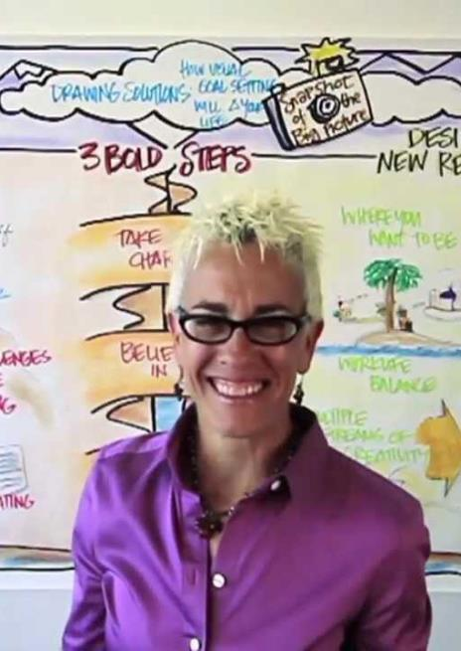
“DRAW YOUR FUTURE”
VISUAL APPROACH TO GOAL SETTING
Goal Setting Isn’t Rocket Science
Visual goal setter Patti Dobrowolski captivates and inspires audiences using the business leadership tool: Drawing Solutions.
Drawing your future helps you to set your goals, envision your desired future, create positive change, enhance culture and accelerate team performance for a better bottom line.
VISIT https://www.upyourcreativegenius.com

Slide 53
EXERCISE: WATCH VISUAL GOAL SETTING “DRAW YOUR FUTURE”
In this TEDx talk, Patti draws a visual representation for the future and desired reality of Joe, an aspiring entrepreneur.
Click to watch the video https://www.youtube.com/watch?v=zESeeaFDVSw

Slide 54
“DRAW YOUR FUTURE” TEMPLATE
Source: http://pattidobrowolski.com/product-category/free-downloads/

Slide 55
EXERCISE: HOW TO “DRAW YOUR FUTURE”
This is an activity will help you map your future. Get a large blank page
Starting on the left write 1–2-word representations of where you're currently at. After writing each word draw a small picture to visually represent it. It doesn't have to be an exact visual, it could be a question mark or exclamation point around an area of tension, confusion, etc.
Do the same thing for the other side, drawing what you want your future to be. In between the two sides are three arrows.
After finishing writing down as many words and pictures as possible, use the arrows to write three "action steps" that can help make that imagined future a reality.

Slide 56
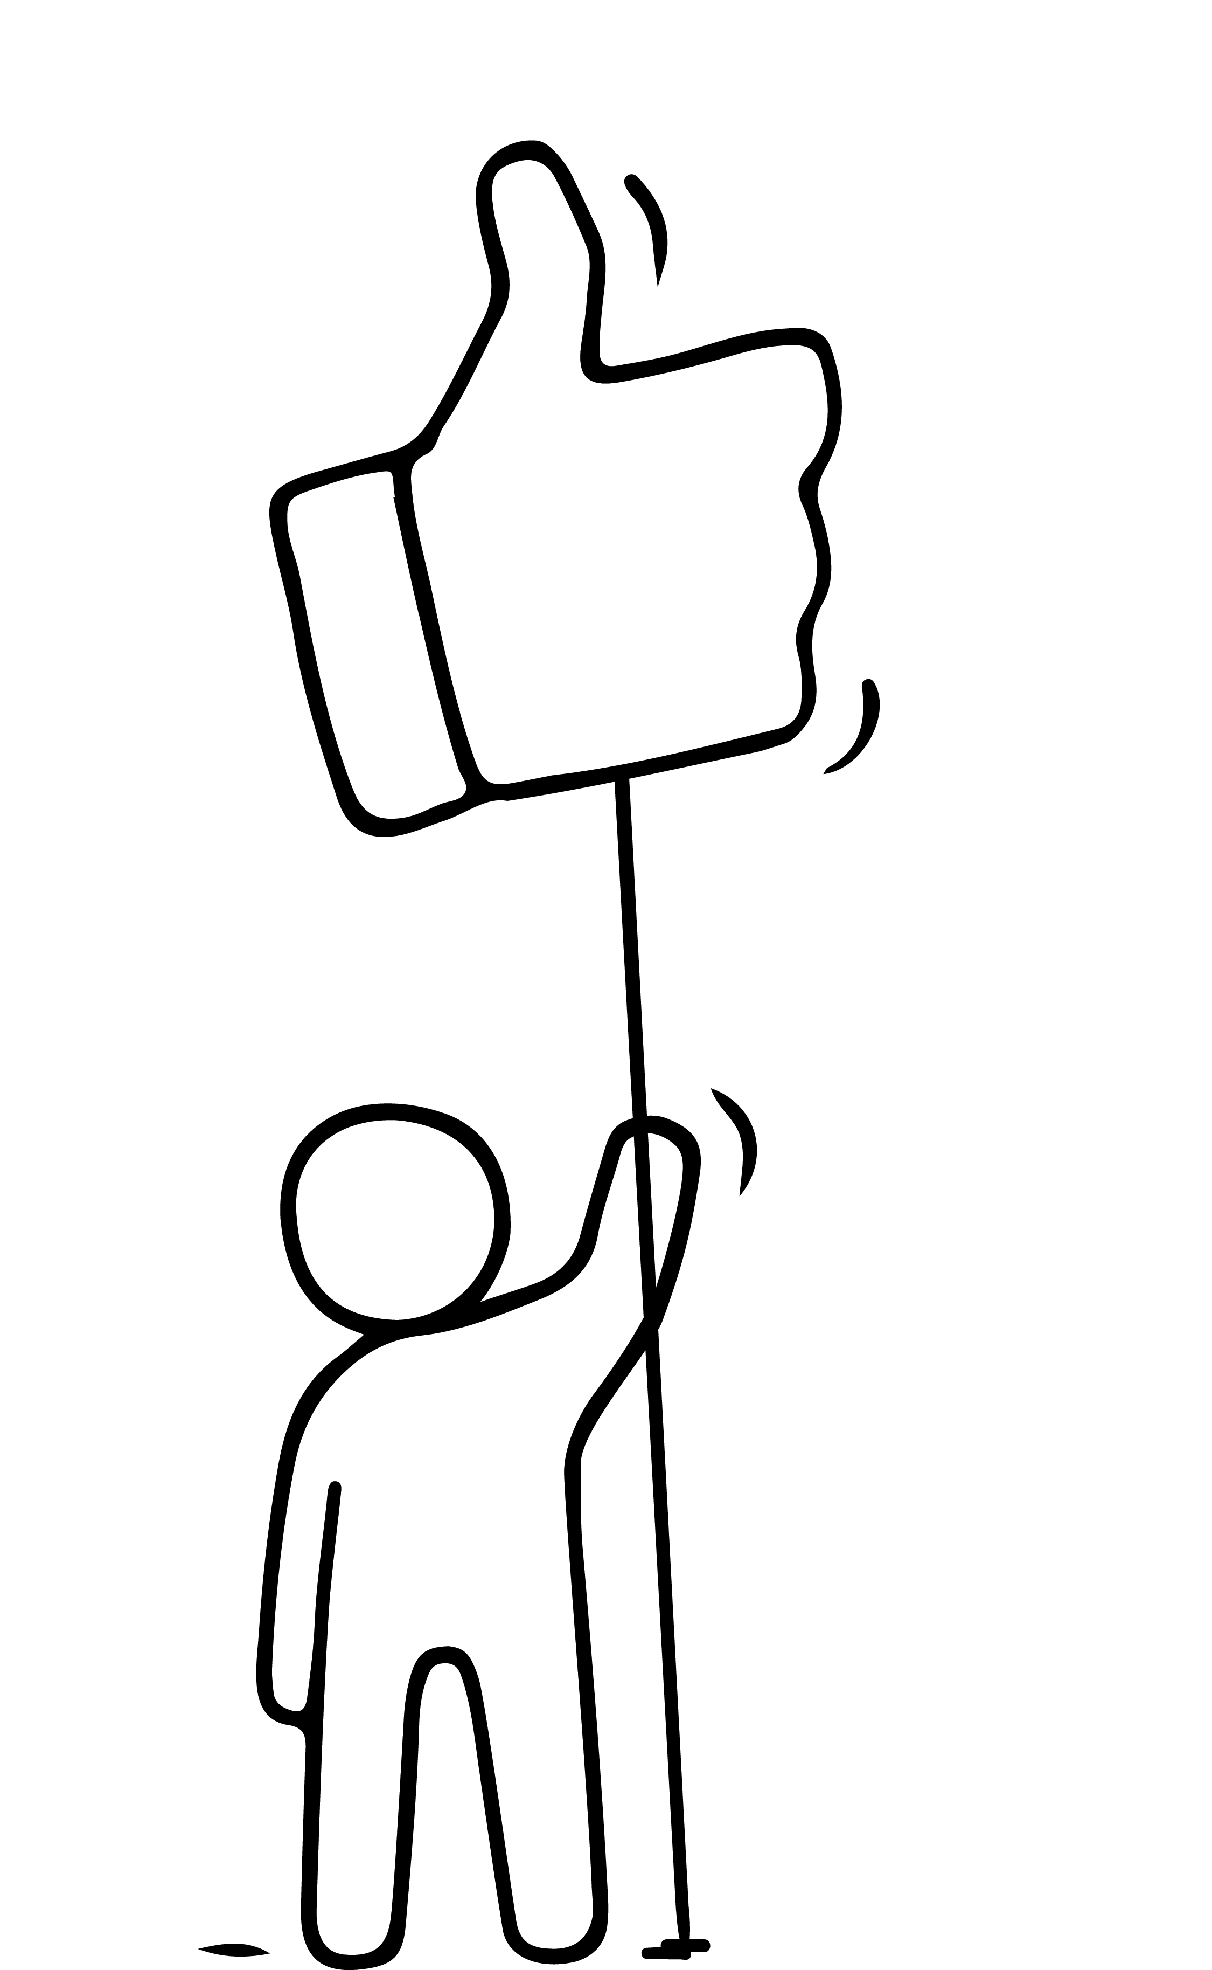
PRIORITISING WHAT’S IMPORTANT
While we may set ourselves well thought through goals, unless we prioritise, we risk not achieving them. But there are other priorities in the mix!
PRIORITISE YOUR FAMILY
As an entrepreneur, no matter how much you want your business to succeed, for most of us, our families have to come first.
READ – Some really interesting articles …
Research: Women Entrepreneurs Struggling & Innovating in the Face of COVID-19 - Cherie Blair Foundation for Women
Its a Juggling Act: Work Life Balance for Women Entrepreneurs | Travel, Technology and More... (poonamsagar.com)
How Can Women Entrepreneurs Balance Their Personal Life And Their Work Life? - Leadership Girl

Slide 57
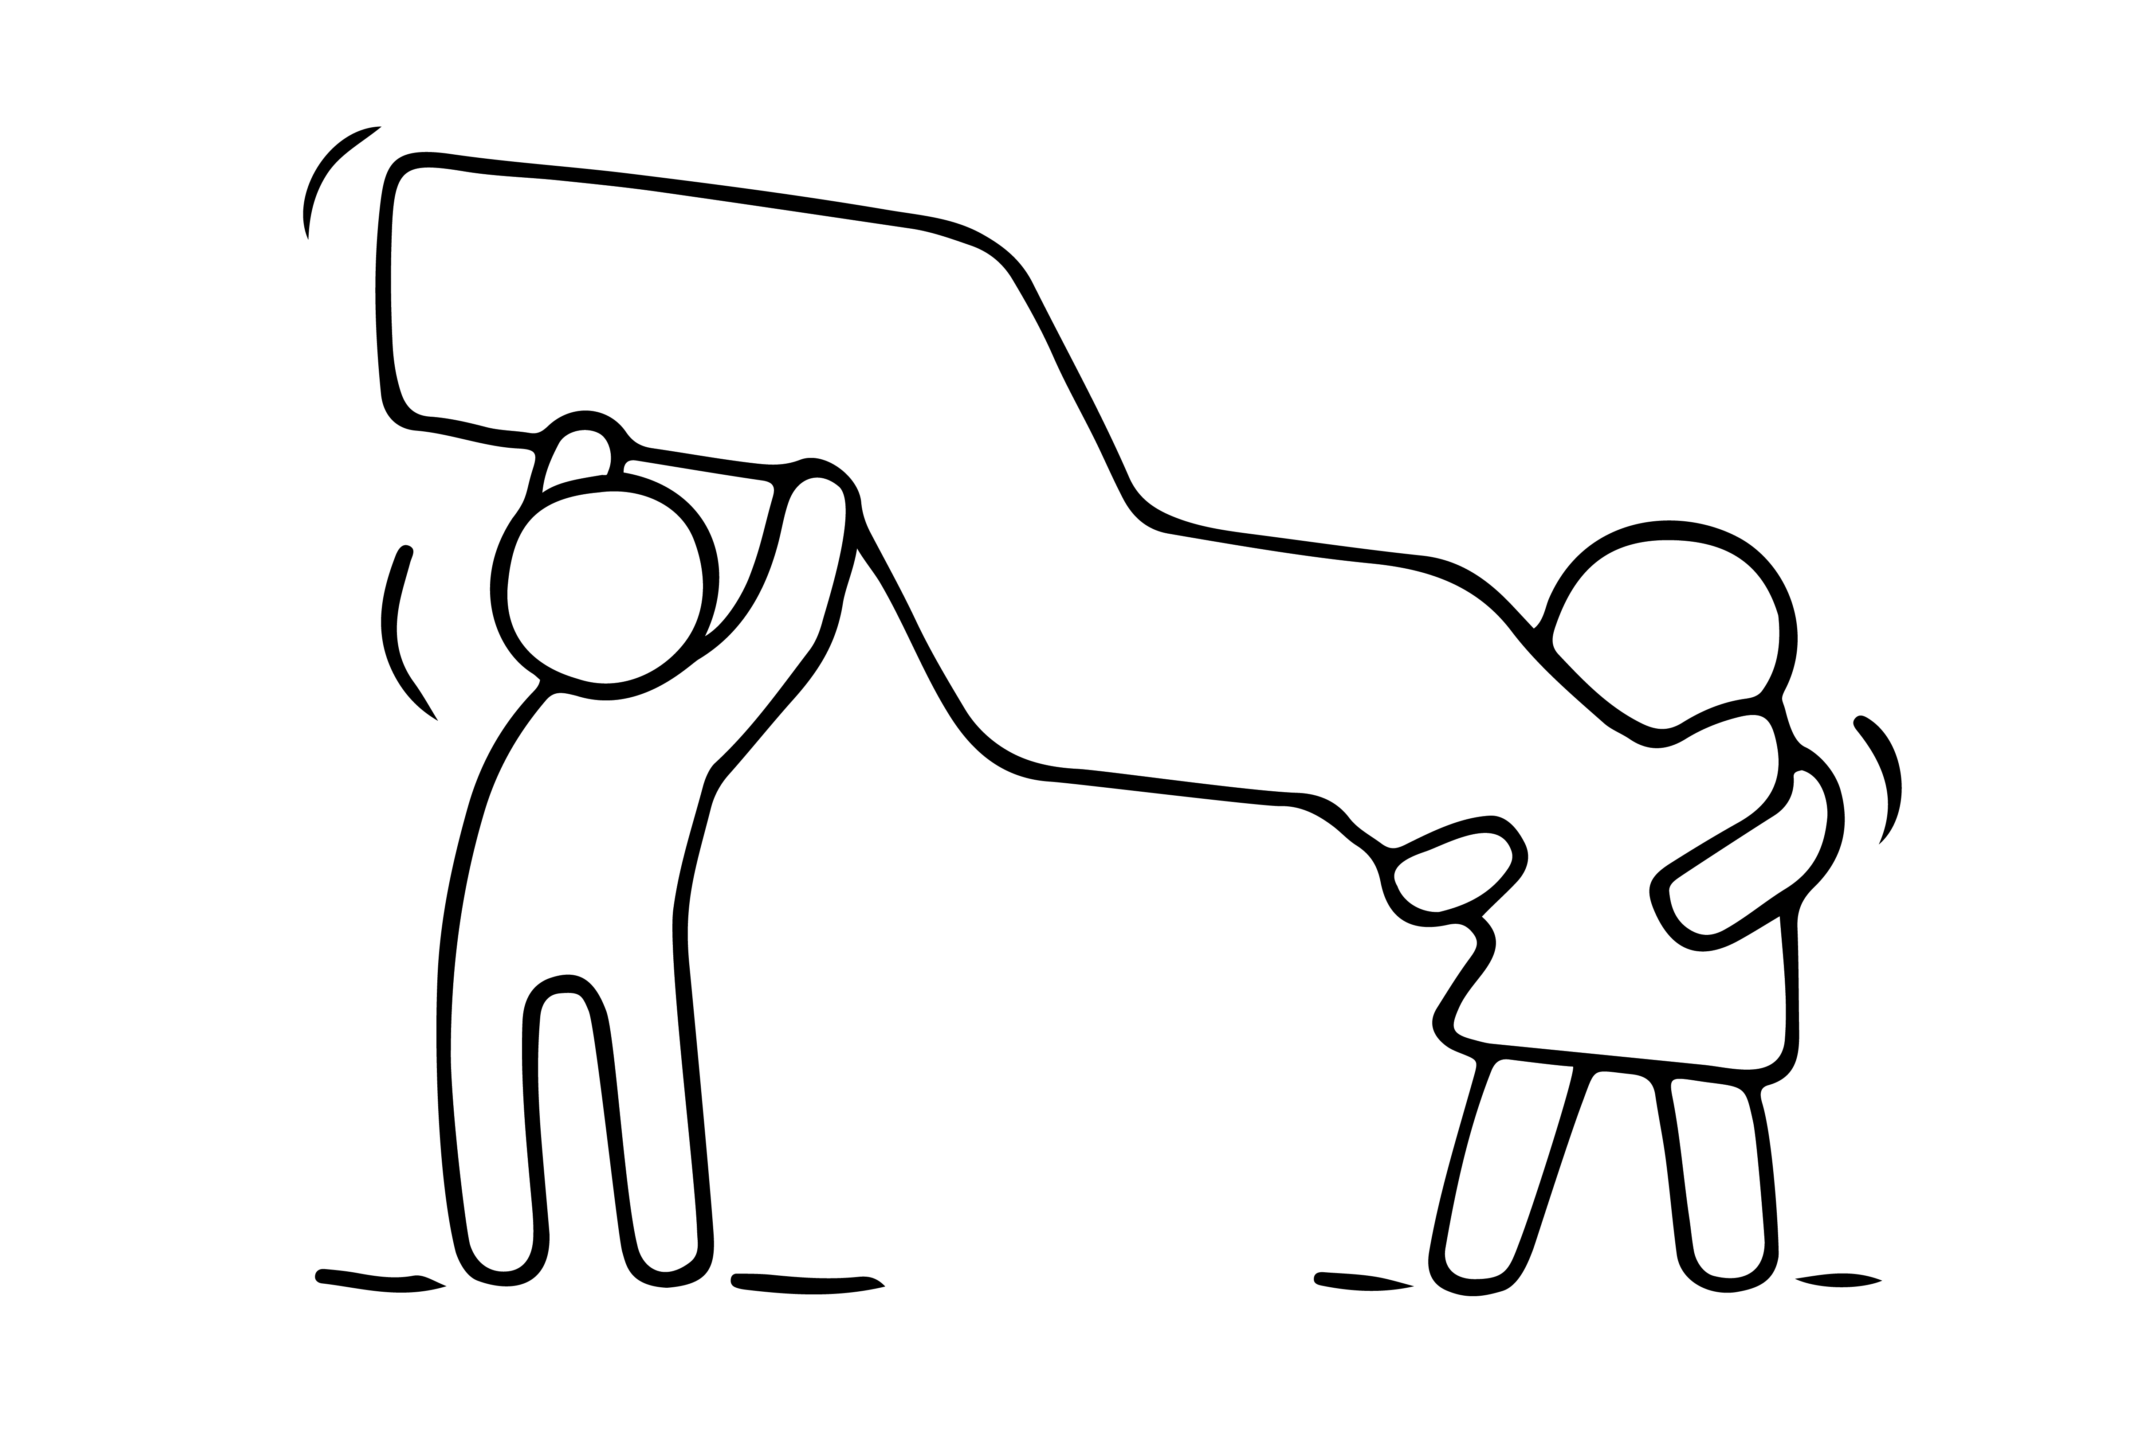
LOOK TO THE FUTURE
Stand back and look beyond today to determine what's in the best interest of your business and yourself over the long run.
Most highly successful women entrepreneurs will tell you that from the time they started out, they knew It is impossible to be great at every aspect of the business. To succeed, you must focus your time on the critical activities.
Plan for growth.

Slide 58
Plan for Growth
When you are ready to hire, hire people you can count on .
Make sure you fill your business with people you can trust to do great work, and people you genuinely enjoy being around.
If your business is filled with enjoyable, hardworking people, you’ll be far less stressed about whether your business has the potential to make it—and it will be easier for you to take time out.

Slide 59
We leave you with an invitation to join our EMIMENT KNOWLEDGE EXCHANGE
Open Online Platform EN - Eminent Project

Slide 60
Congratulations!
We hope you have both enjoyed and benefitted from joining our EMIMENT entrepreneurship journey. Our team wishes you nothing but success.
Always focus on how you can win. Work hard, and be true to yourself.
YOU HAVE COMPLETED OUR LEARNING JOURNEY

